Slide 1
Class 1 Essential Knowledge
Autumn 1 2025

Slide 2

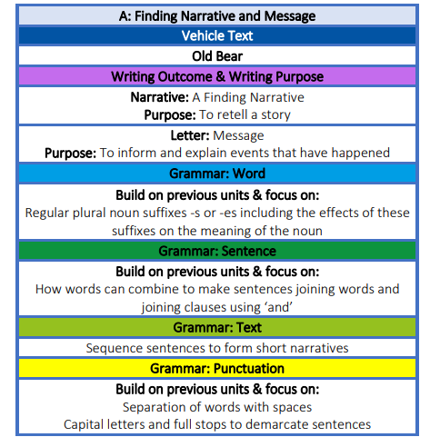
English
In English we are looking at the story ‘Old Bear’ by Jane Hissey

Slide 3
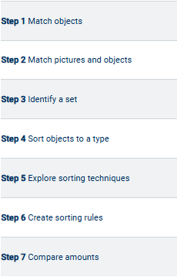
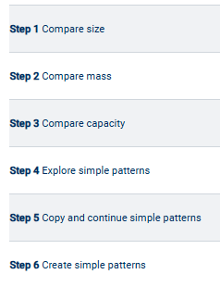
RECEPTION MATHS
Week 1 and 2
We will use the first two weeks to get to know the children and settling them in to our school family.
Week 3 & 4
Week 5 & 6

Slide 4
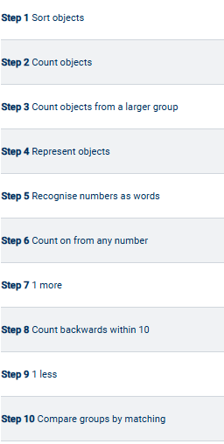
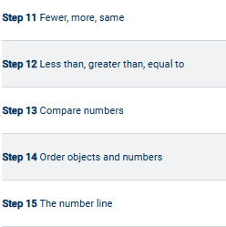
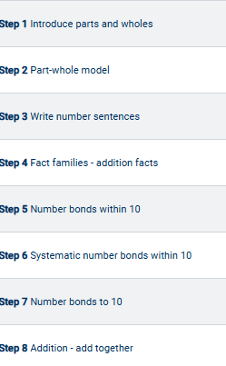
Year 1 Maths
Week 1 & 2
Week 3 &4
Week 5 & 6

Slide 5
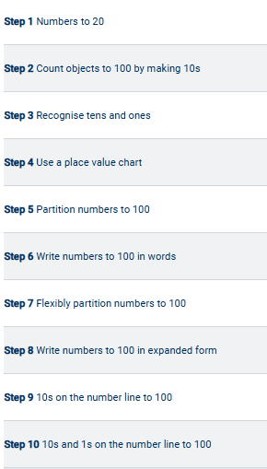
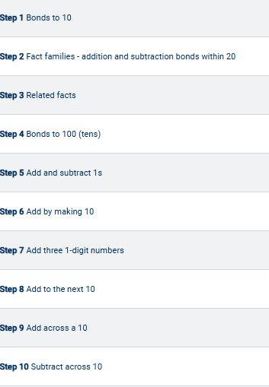
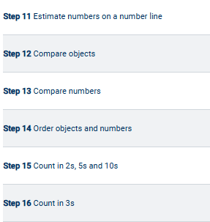
Year 2 - Maths
Week 1 & 2
Week 3 & 4
Week 5 & 6

Slide 6
Living memory is the past that can be remembered by people who are alive today.
History
My Family History
timeline
past
(before now)
present
(now)
grandpa
gran
grandad
nanna
mummy
daddy
Sources:
We will learn that a source is something that can tell us about the past.
-diaries
-books
-people
-objects (artefacts)
-pictures/photographs
sister
child
We will be learning all about FAMILY TREEs and how there are generations of people in our families!
Notes:
Wright brothers’ plane (Public Domain): https://fr.wikipedia.org/wiki/Wright_Flyer_II#/media/Fichier:1904WrightFlyer.jpg
Train Number One, July 1925 (sepia photo) - The Stapleton Collection / Bridgeman Images
Apollo 11 Crew (Public Domain): https://en.wikipedia.org/wiki/Neil_Armstrong#/media/File:Apollo_11_Prime_Crew_-_GPN-2000-001164_-_Ap11-s69-31740.jpg
Tudor transport: United Learning

Slide 7
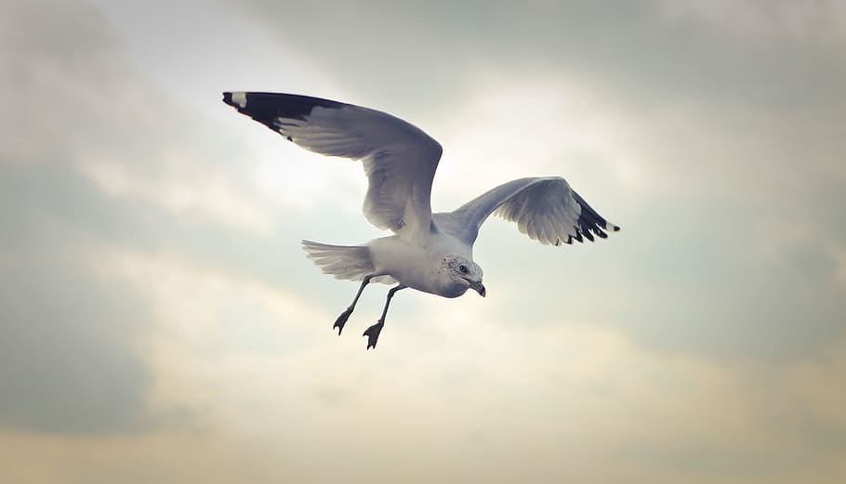
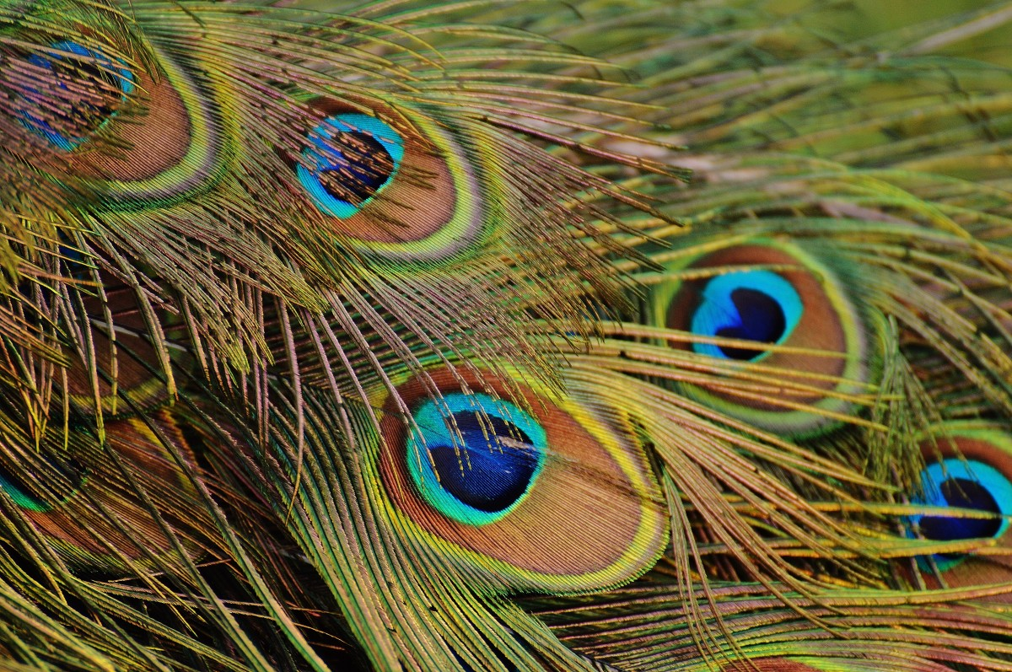
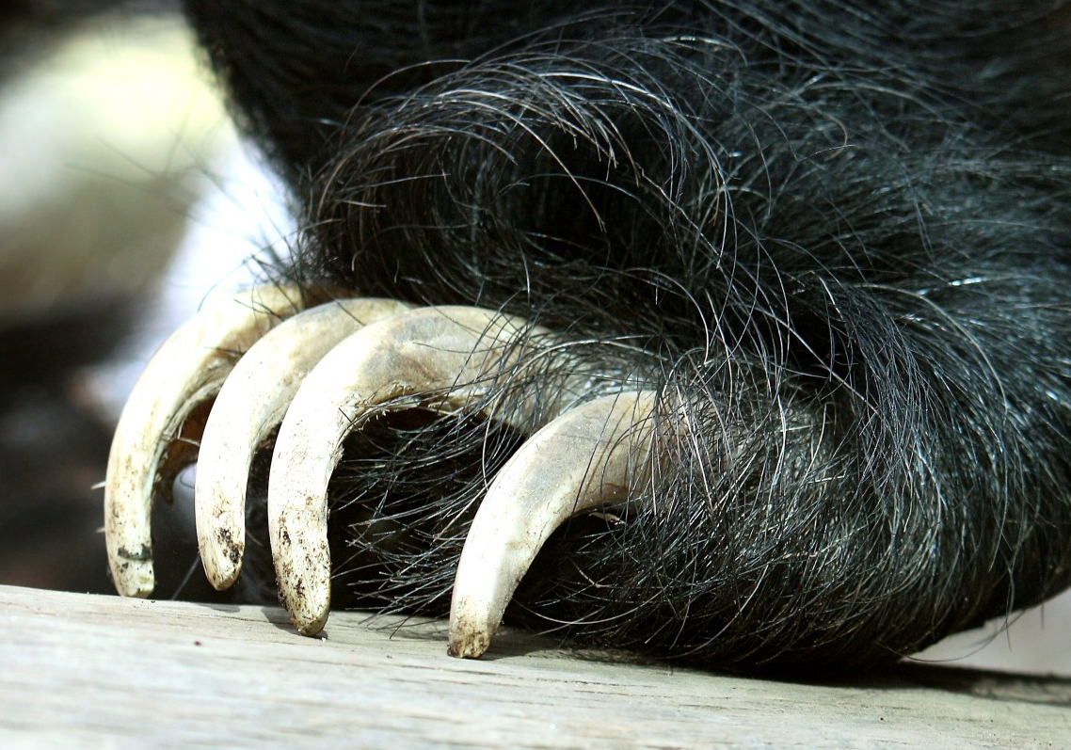
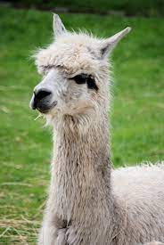
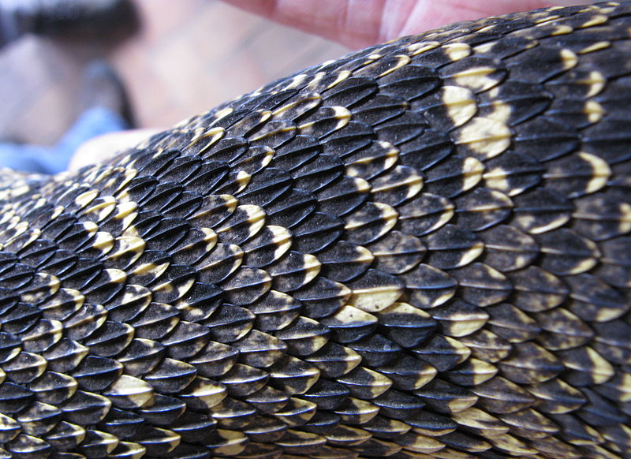
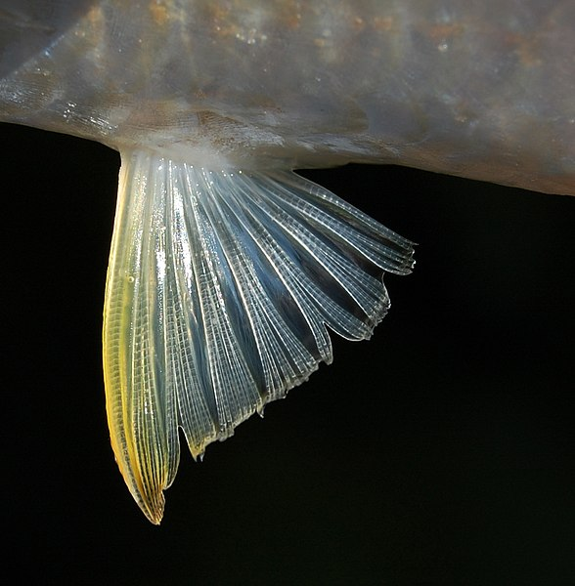
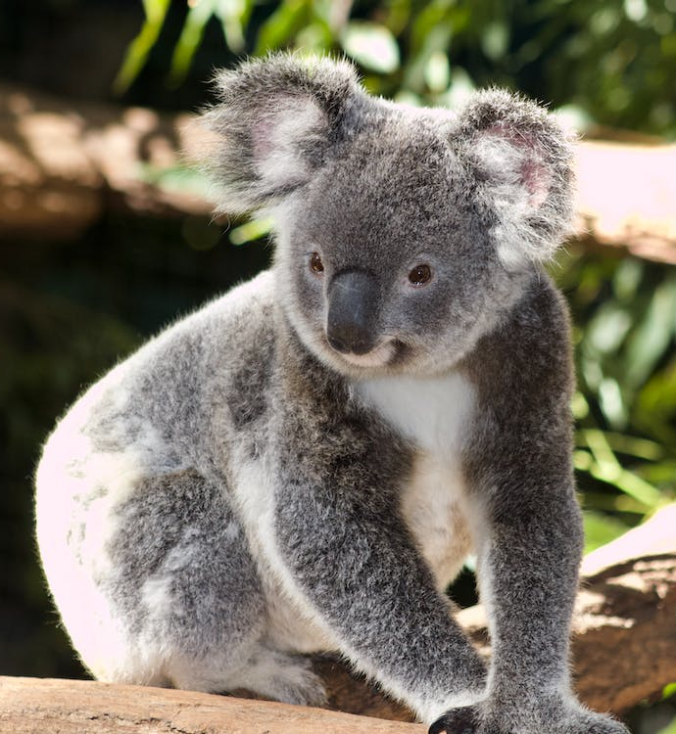
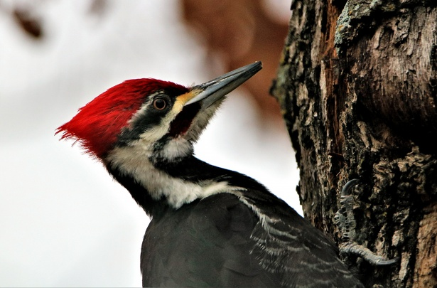
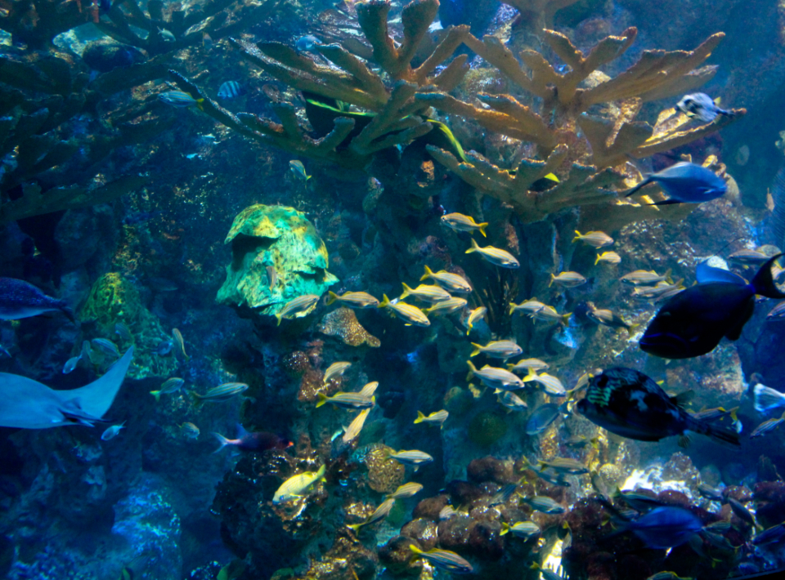
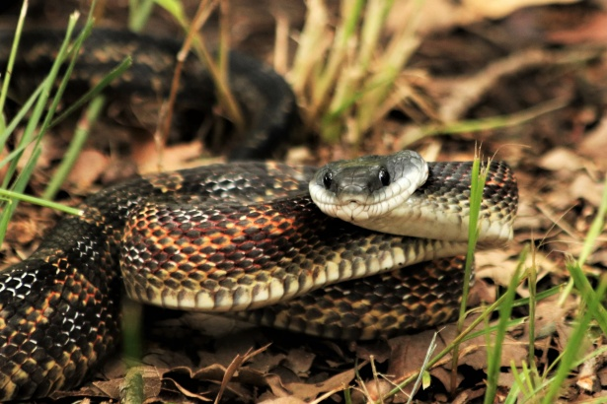
Science
Features
Animals have many different features. Some have wings and feathers, others have paws and claws, some have fur, and some have scales and fins.
wings
feathers
claws
hair
scales
fins
Groups
Animals belong to one of 5 different groups: mammals, birds, fish, reptiles and amphibians.
mammal
bird
fish
reptile
amphibian
Animals eat different foods.
Some animals only eat plants. They are called herbivores.
Some animals only eat other animals. They are called carnivores.
Some animals eat plants and animals. They are called omnivores.
Food

Slide 8
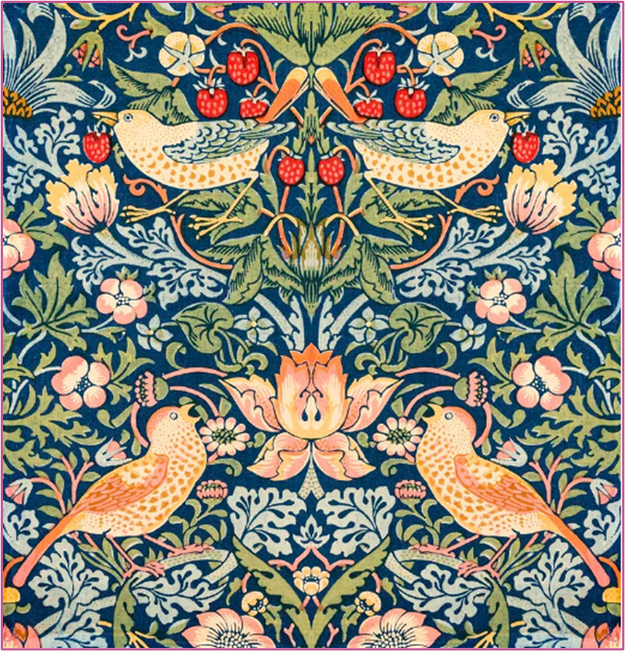
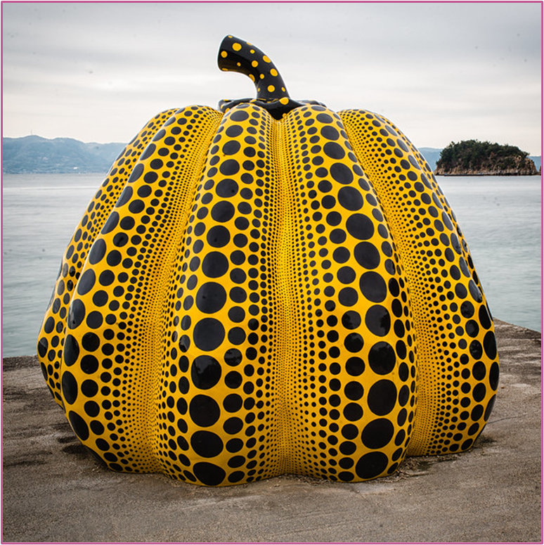
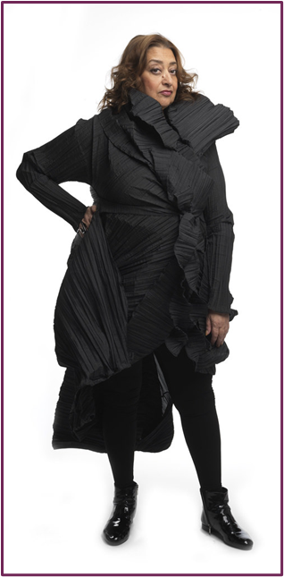
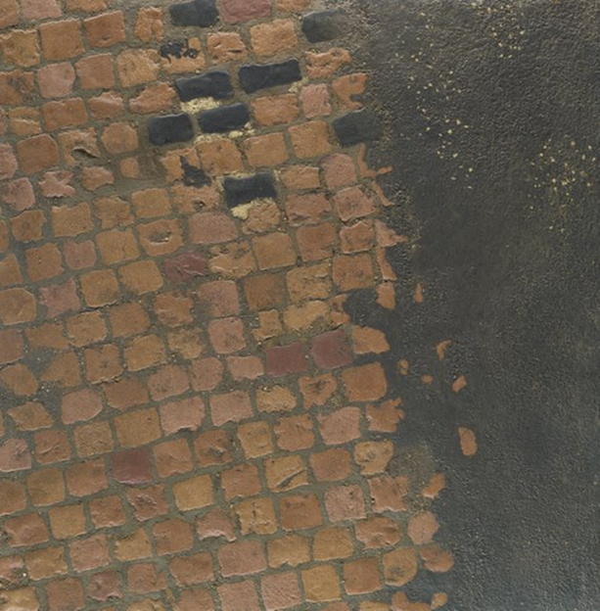
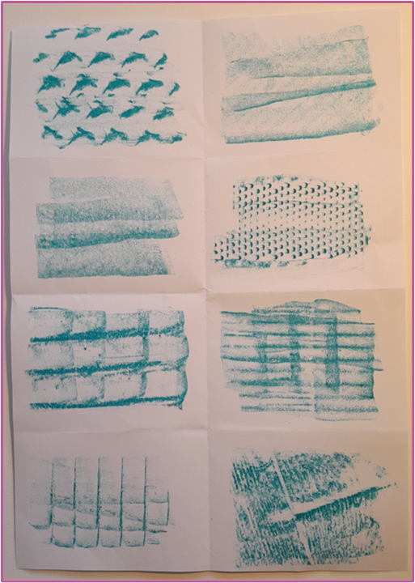
Art – Our School
Pattern and texture
Pattern is a repeating design.
Texture is how something feels.
Our school was designed by an architect.
Everything that is man-made has been designed by a specific type of artist.
An architect is an artist who designs buildings. Zaha Hadid designed famous buildings that look exciting and unusual.

Slide 9

PSHE – Being Healthy
In PSHE this half term we are going to learning all about being healthy. We are going to be talk about all the things that our bodies need to be healthy and how we can look after ourselves!

Slide 10

Computing
In computing we are going to be talking about internet safety and all of the technology that is around us in our world.
We are going to be learning about what different technology is used for and how it can help us.

Slide 11

R.E
Our I wonder question for this half term is:
‘Who is a Christian and what do they believe?’
We are going to explore Christianity, what Christians believe in and how they show their beliefs.

