Slide 1
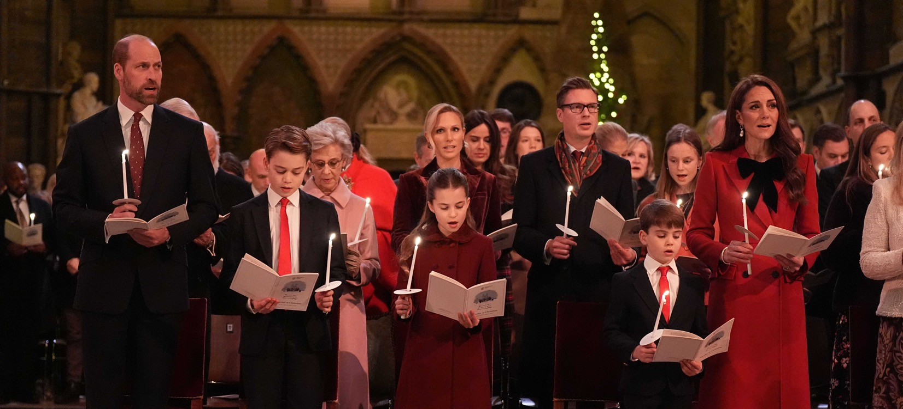
What’s happening
in the news this week?
Aaron Chown/WPA Pool/Shutterstock
Let’s have a look at this week’s poster!
1st – 7th December 2025

Slide 2
Togetherness
Christian Value: Compassion
God
Creation
Fall
People of God
Incarnation
Gospel
Salvation
Kingdom of God
© Picture News 2025

Slide 3
On Friday, the Princess of Wales will host her annual carol service, which will bring people together to celebrate kindness, connection, and community. The event aims to show how love can link people of all ages, backgrounds, and beliefs, especially at times when the world can feel divided. It encourages everyone to think about the power of togetherness and the importance of supporting one another with compassion and joy.

Slide 4
Think together
and talk

Slide 5
Think together and talk
What is togetherness?
Have you ever felt a sense of togetherness and belonging? What made you feel this way?
Have you ever noticed a small act of kindness make a big difference in someone's day? What was the act?

Slide 6
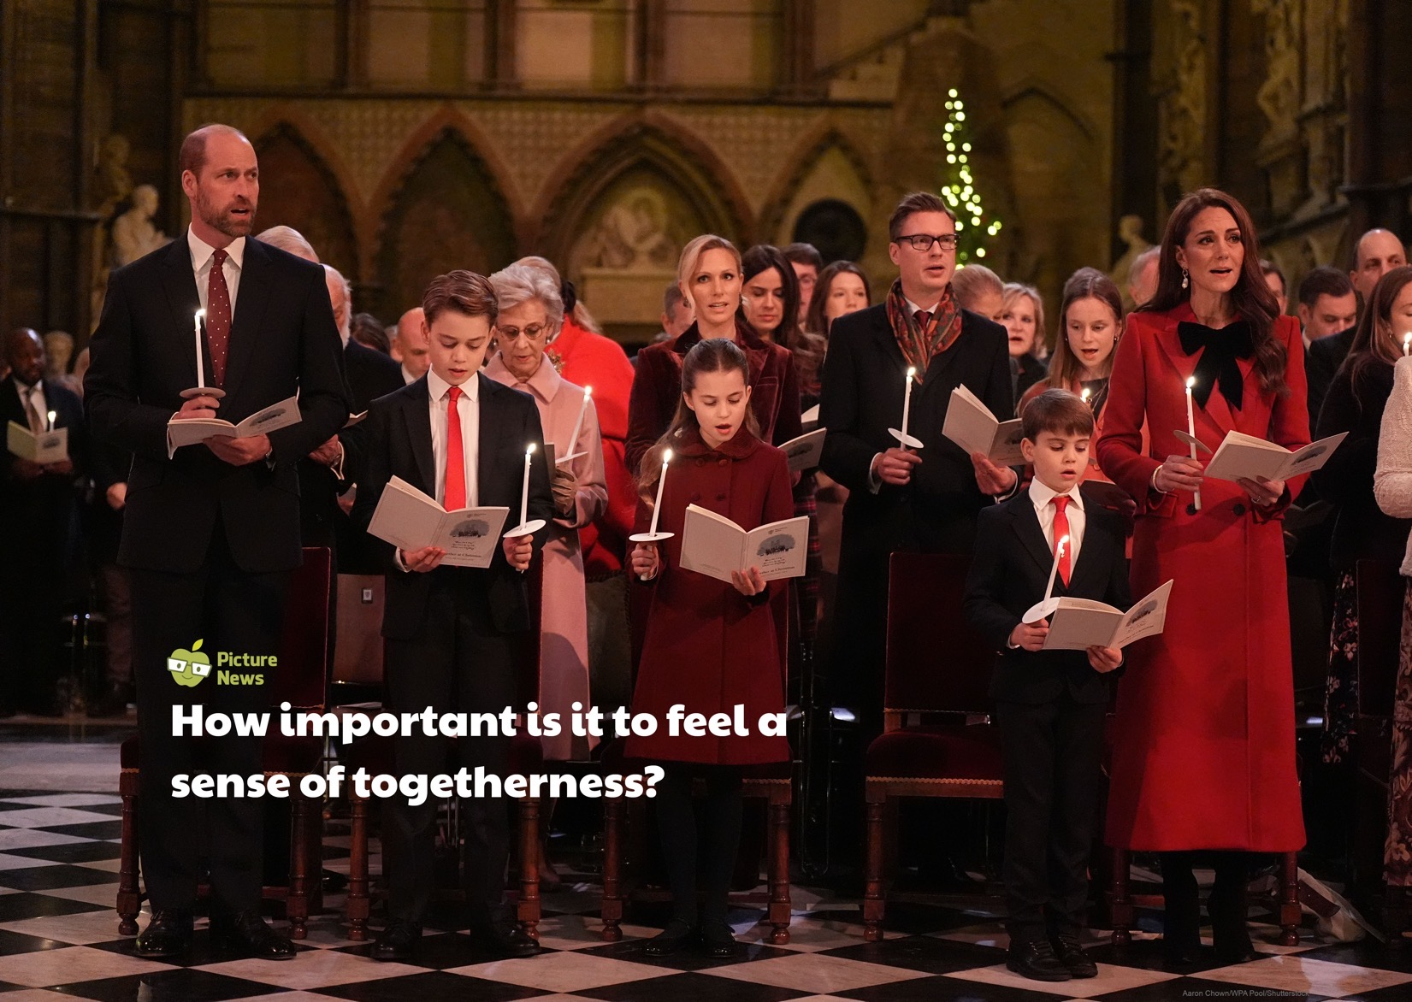

Slide 7
What does the Bible
have to say?

Slide 8
The Bible teaches that true faith is about taking action. Christians are taught to show compassion by caring for those who are in need.
These acts of kindness help build a strong, happy community where everyone feels they belong. For Christians, helping other people is a way to show their love for God.

Slide 9
‘Then the King will say to those on his right,
“Come, you who are blessed by my Father; take
your inheritance, the kingdom prepared for you since the creation of the world. For I was hungry and you gave me something to eat, I was thirsty and you gave me something to drink, I was a stranger and you invited me in, I needed clothes and you clothed me, I was ill and you looked after me, I was in prison and you came to visit me.”
Matthew 25:34-36

Slide 10
What do others think?

Slide 11
Even the weak become strong when they are united.
Friedrich von Schiller
- playwright

Slide 12
Time to be quiet
and to pray

Slide 13
Prayer
Dear God,
Thank You for our groups and communities.
Help us be the first to step forward when we see someone who needs a friend or a helping hand.
Let our kindness spread from one person to the next.
Amen.

Slide 14
Continue thinking

Slide 15
Key Stage 1 class discussion
How does it feel to belong to a group? What makes a group feel welcoming?
How might someone feel if they don’t feel like they belong?
What is something special about you that makes you a great part of any group?

Slide 16
Key Stage 2 class discussion
What are some benefits to belonging to a group?
Is every single person in a group responsible for making others feel included? How so?
What is the most powerful thing a group can do to show a person that they matter?

Slide 17
How can we take our learning about togetherness out into the world and make a positive difference this week?

Slide 18
Time to worship
O Come All Ye Faithful
Click here for the hymn online

Slide 19
O come, all ye faithful, joyful and triumphant,
O come ye, O come ye to Bethlehem!
Come, and behold Him, born the King of angels!

Slide 20
O come, let us adore Him;
O come, let us adore Him;
O come, let us adore Him, Christ, the Lord.

Slide 21
God of God, Light of Light,
lo, He abhors not the virgin's womb;
very God, begotten not created;

Slide 22
O come, let us adore Him;
O come, let us adore Him;
O come, let us adore Him, Christ, the Lord.

Slide 23
Sing, choirs of angels; sing in exultation;
sing, all ye citizens of heav'n above!
Glory to God, all glory in the highest!

Slide 24
O come, let us adore Him;
O come, let us adore Him;
O come, let us adore Him, Christ, the Lord.

Slide 25
Yea, Lord, we greet Thee, born this happy morning;
Jesus, to Thee be all glory giv'n!
Word of the Father, now in flesh appearing!

Slide 26
O come, let us adore Him;
O come, let us adore Him;
O come, let us adore Him, Christ, the Lord.

Slide 27
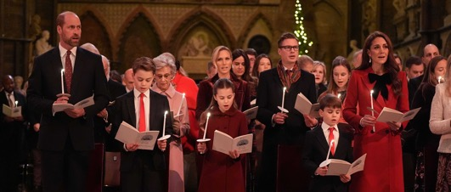
Collective
Worship
Bible link: Matthew 25:34-36
Biblical value: Compassion
Theme: Togetherness
Invitation prayer
Dear God,
Thank You for our groups and communities.
Help us be the first to step forward when we see someone who needs a friend or a helping hand.
Let our kindness spread from one person to the next.
Amen.
Pupil talk
What is togetherness?
Have you ever felt a sense of togetherness and belonging? What made you feel this way?
Have you ever noticed a small act of kindness make a big difference in someone's day? What was the act?
Key stage 1 class discussion
How does it feel to belong to a group? What makes a group feel welcoming?
How might someone feel if they don’t feel like they belong?
What is something special about you that makes you a great part of any group?
Pupil involvement
Think
Start by showing a picture of a complex building or beautiful artwork.
Ask the children to look at the building/artwork. Explain that it's beautiful, then ask the children to imagine that a piece was missing, or if some pieces didn't quite fit together. Ask the children: Would it be complete? Would it be as strong/beautiful?
Explain that school is just the same. Every child, teacher, and staff member is a unique piece. Our togetherness means we rely on each other to make the whole picture complete and strong. No piece is too small, and every piece matters.
Ask the children: What are some things you might be able to do to make sure every piece knows where they belong?
On Friday, the Princess of Wales will host her annual carol service, which will bring people together to celebrate kindness, connection, and community. The event aims to show how love can link people of all ages, backgrounds, and beliefs, especially at times when the world can feel divided. It encourages everyone to think about the power of togetherness and the importance of supporting one another with compassion and joy.
The Bible teaches that true faith is about taking action. Christians are taught to show compassion by caring for those who are in need.
These acts of kindness help build a strong, happy community where everyone feels they belong. For Christians, helping other people is a way to show their love for God.
Key stage 2 class discussion
What are some benefits to belonging to a group?
Is every single person in a group responsible for making others feel included? How so?
What is the most powerful thing a group can do to show a person that they matter?
Worship song
O Come All Ye Faithful
God
Creation
Fall
People of God
Incarnation
Gospel
Salvation
Kingdom of God
© Picture News 2025

