Slide 1

What’s happening
in the news this week?
McDonald’s
Let’s have a look at this week’s poster!
24th – 30th November 2025

Slide 2
Creativity
Christian Value: Joy
God
Creation
Fall
People of God
Incarnation
Gospel
Salvation
Kingdom of God
© Picture News 2025

Slide 3
McDonald’s changed the colours of its famous Happy Meal box in the UK, making it white on three sides, for children to colour and design it themselves. The company said the new boxes encourage creativity and let children express their ideas and feelings through drawing. Four million of the new ‘colour-your-own’ boxes have been given out as a trial to see how children respond.

Slide 4
Think together
and talk

Slide 5
Think together and talk
What are some different ways we can be creative?
How are you creative?
Are there any unique skills you use when you are being creative?
Is creativity something you enjoy? How so?

Slide 6
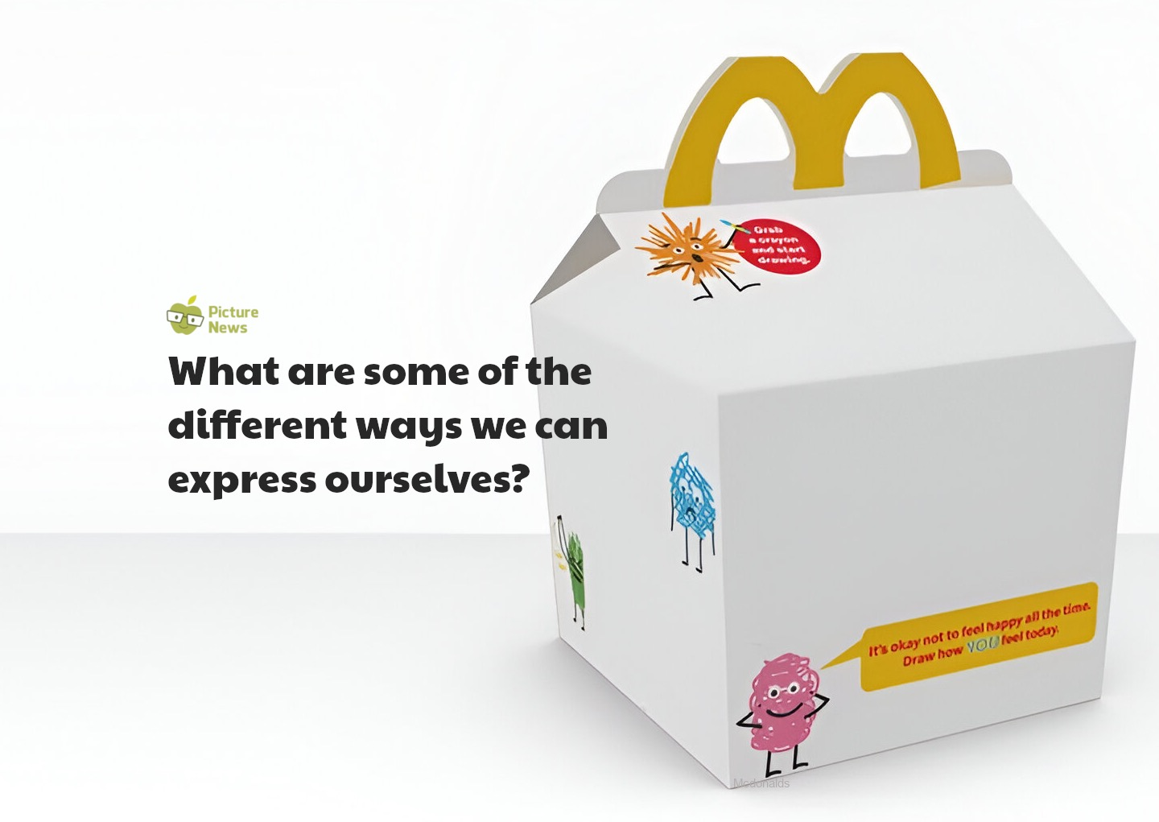

Slide 7
What does the Bible
have to say?

Slide 8
The Bible explains when you create something that is truly yours and unlike anyone else’s, whether it's a song, a drawing, or a unique solution to a problem, you are honouring God and His creativity. Being creative and making things that are unique is a reflection of who we are, and our special relationship with God.

Slide 9
Sing joyfully to the Lord, you righteous;
it is fitting for the upright to praise him.
Praise the Lord with the harp;
make music to him on the ten-stringed lyre.
Sing to him a new song;
play skilfully, and shout for joy.
Psalm 33: 1-3

Slide 10
What do others think?

Slide 11
You can't use up creativity. The more you use, the more you have.
Maya Angelou – writer and
civil rights activist

Slide 12
Time to be quiet
and to pray

Slide 13
Prayer
Dear God,
Thank You for the gift of creativity.
Please help us to use our minds to invent, explore and create.
Remind us to be creative in everything we do, and to share our unique gifts with the world.
Amen.

Slide 14
Continue thinking

Slide 15
Key Stage 1 class discussion
How do you use your imagination? How do you feel when you are using your imagination?
What are some ways we can show others our ideas and thoughts? Is it always easy? How so?
If you had a ‘creativity superpower’, what would it let you do? Why?

Slide 16
Key Stage 2 class discussion
When do you feel most inspired to be creative?
What activities help you to invent, explore and be creative? How does it feel when you are being creative? Why?
Is using our creativity important? How so?
What might the world look like with no creativity?

Slide 17
How can you apply what you have learned about creativity to your life and activities this week?

Slide 18
Time to worship
One More Step
Click here for the hymn online

Slide 19
One more step along the world I go,
One more step along the world I go;
From the old things to the new,
Keep me travelling along with you:
And it's from the old I travel to the new;
Keep me travelling along with you.

Slide 20
Round the corners of the world I turn,
More and more about the world I learn;
And the new things that I see,
You'll be looking at along with me.
And it's from the old I travel to the new;
Keep me travelling along with you.

Slide 21
As I travel through the bad and good,
Keep me travelling the way I should,
Where I see no way to go,
You'll be telling me the way, I know,
And it's from the old I travel to the new;
Keep me travelling along with you.

Slide 22
Give me courage when the world is rough,
Keep me loving though the world is tough;
Leap and sing in all I do,
Keep me travelling along with you:
And it's from the old I travel to the new;
Keep me travelling along with you.

Slide 23
You are older than the world can be,
You are younger than the life in me;
Ever old and ever new,
Keep me travelling along with you:
And it's from the old I travel to the new;
Keep me travelling along with you.

Slide 24

Collective
Worship
Invitation prayer
Bible link: Psalm 33: 1-3
Biblical value: Joy
Theme: Creativity
Dear God,
Thank You for the gift of creativity.
Please help us to use our minds to invent, explore and create.
Remind us to be creative in everything we do, and to share our unique gifts with the world.
Amen.
Pupil talk
What are some different ways we can be creative?
How are you creative?
Are there any unique skills you use when you are being creative?
Is creativity something you enjoy? How so?
Key stage 1 class discussion
How do you use your imagination? How do you feel when you are using your imagination?
What are some ways we can show others our ideas and thoughts? Is it always easy? How so?
If you had a ‘creativity superpower’, what would it let you do? Why?
Pupil involvement
Think
Start by explaining that, today, we are going to think about creative ways we can express ourselves. Organise the children to into small groups. Introduce the activity, to come up with a creative way to demonstrate the phrase 'Express Yourself!’. The groups must interpret the phrase and find an original method to show what it means to them. This might be done through drama or a song, for example. Give the children a set amount of time to put together their creative pieces. Then, the children can show what they have created.
Ask the children: How did your group decide on the way to express yourselves? Is it always easy to express yourself? What makes it difficult sometimes? Did seeing other groups' performances give you new ideas about what expressing yourself means? What did you learn from the activity?
McDonald’s changed the colours of its famous Happy Meal box in the UK, making it white on three sides, for children to colour and design it themselves. The company said the new boxes encourage creativity and let children express their ideas and feelings through drawing. Four million of the new ‘colour-your-own’ boxes have been given out as a trial to see how children respond.
The Bible explains when you create something that is truly yours and unlike anyone else’s, whether it's a song, a drawing, or a unique solution to a problem, you are honouring God and His creativity. Being creative and making things that are unique is a reflection of who we are, and our special relationship with God.
Key stage 2 class discussion
When do you feel most inspired to be creative?
What activities help you to invent, explore and be creative? How does it feel when you are being creative? Why?
Is using our creativity important? How so?
What might the world look like with no creativity?
Worship song
One more step
God
Creation
Fall
People of God
Incarnation
Gospel
Salvation
Kingdom of God
© Picture News 2025

