Slide 1
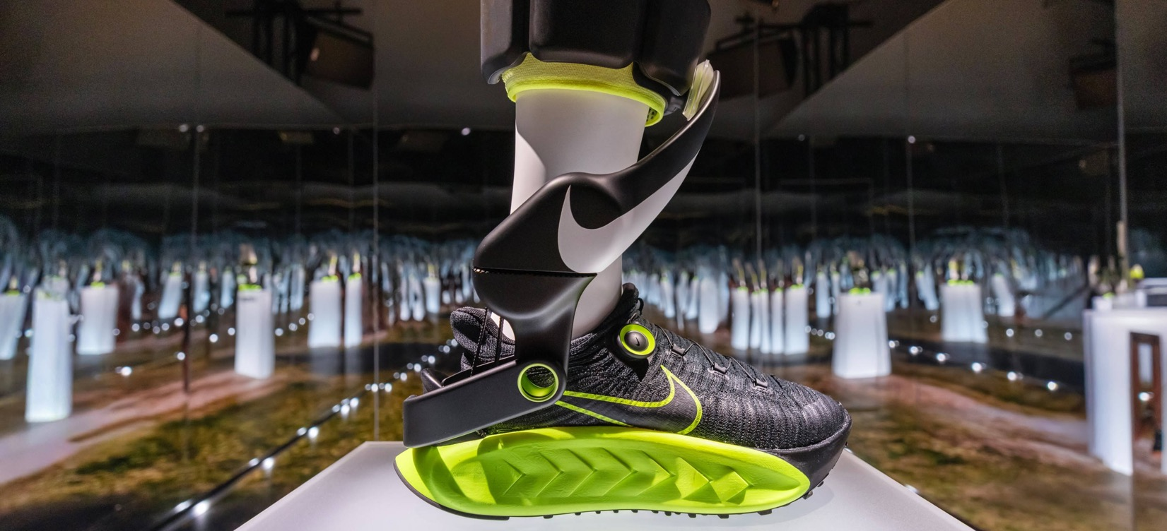
What’s happening
in the news this week?
Nike Media
Let’s have a look at this week’s poster!
17th – 23rd November 2025

Slide 2
The Tech Tug-of-War
Christian Value: Wisdom
God
Creation
Fall
People of God
Incarnation
Gospel
Salvation
Kingdom of God
© Picture News 2025

Slide 3
Nike has revealed a new type of powered shoe, called Project Amplify, which uses small motors to boost a person’s walking and running movement. The shoes are designed to reduce tiredness and make everyday movement easier, especially for those who need extra support. Nike says the aim is to help people stay active, independent and mobile in their daily lives.

Slide 4
Think together
and talk

Slide 5
Think together and talk
What technology do you use in your day-to-day life? How is it helpful?
What is your favourite technology? Why?
What are some benefits to using technology?
How do you think technology might change the future? If you could invent a new technology, what would it be and why?

Slide 6
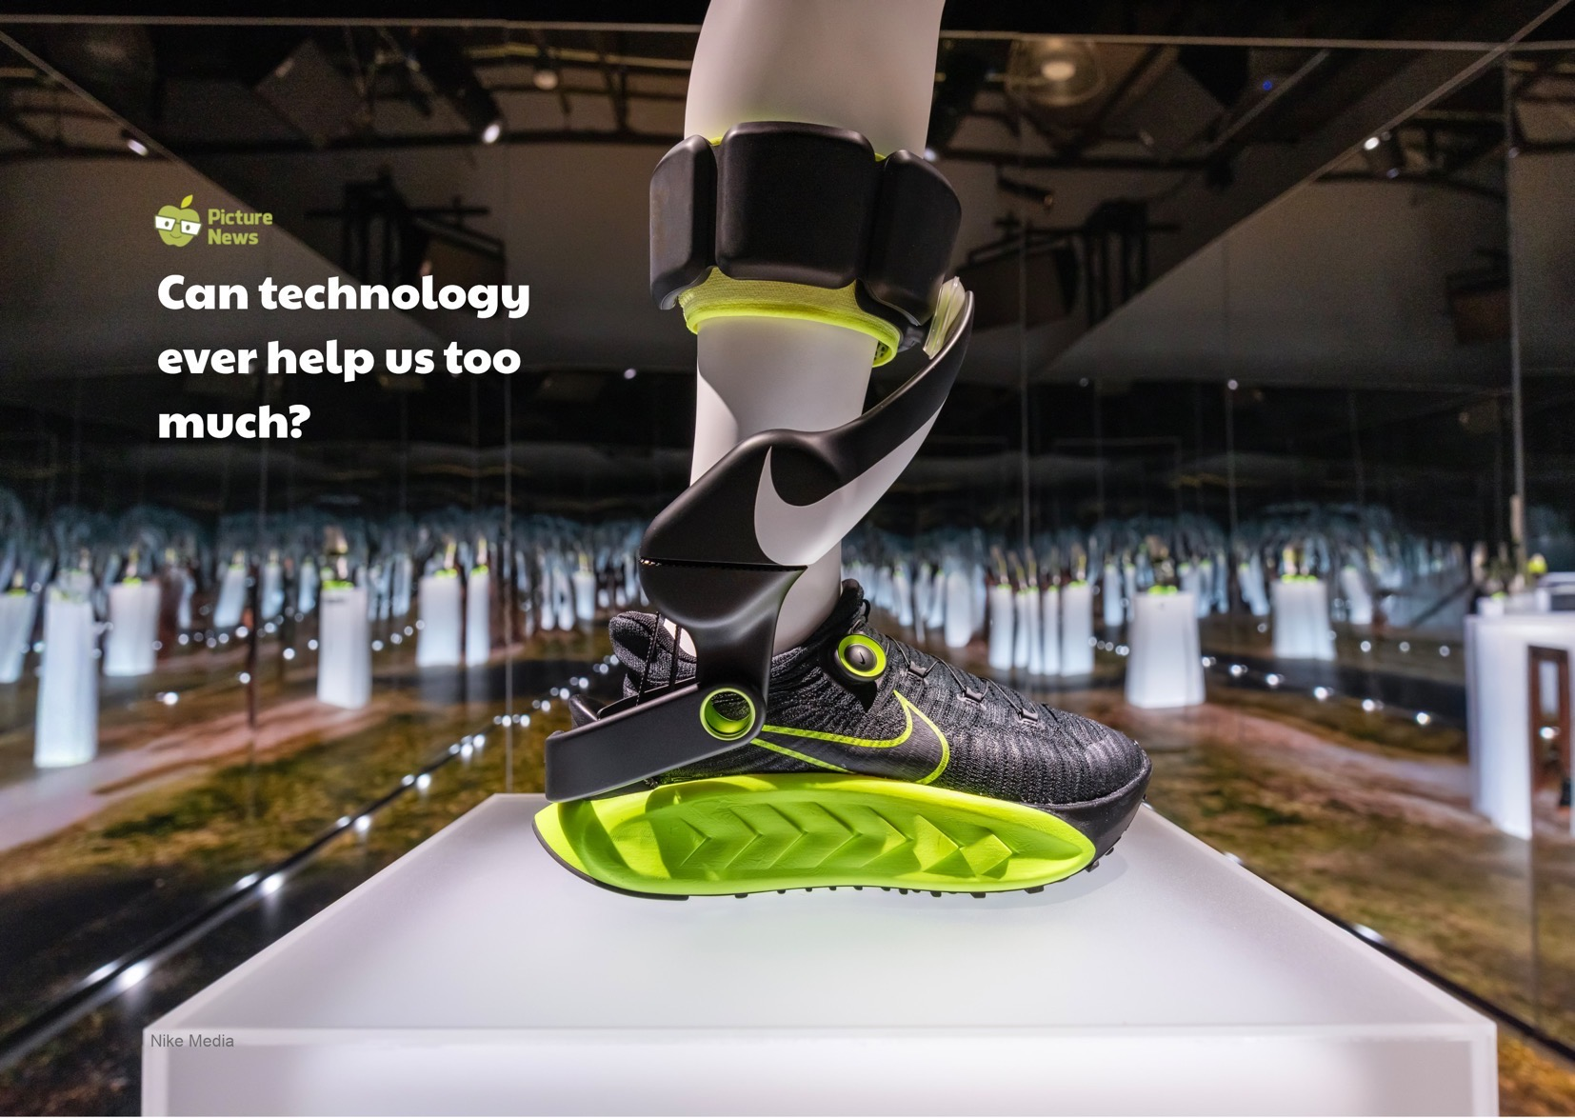

Slide 7
What does the Bible
have to say?

Slide 8
The modern world is busy, with fast, fun and easy technology. Technology is a useful tool which is not bad on its own, it just depends on how we use it. The Bible reminds us that if technology becomes a distraction and we rely on it too much, we should focus on what truly matters, like our contributions to the world, and the quality of our relationships with others.

Slide 9
Do not conform to the pattern of this world, but be transformed by the renewing of your mind. Then you will be able to test and approve what God’s will is – his good, pleasing and perfect will.
Romans 12:2

Slide 10
What do others think?

Slide 11
Science and technology revolutionise our lives, but memory, tradition and myth frame our response.
Arthur Schlesinger - American historian

Slide 12
Time to be quiet
and to pray

Slide 13
Prayer
Dear God,
Thank You for technology. Help us to use these amazing tools for learning, connection, and kindness.
Let us remember what is important and to use our time wisely.
Allow us to be the best we can be today, growing in our talents and wisdom.
Amen.

Slide 14
Continue thinking

Slide 15
Key Stage 1 class discussion
Would you rather find a quick answer on a computer or ask someone else and talk about it? Why?
Do you think our brains have to work harder when we play with something physical, such as a jigsaw, or when we watch a screen? How so?
Is it okay to have times when we don’t use technology? What activities might you do then?

Slide 16
Key Stage 2 class discussion
What tasks or skills can technology now do for us?
Do you think it's important to still practice those skills, even if the technology can do them more quickly? Why?
A computer can often give us an instant answer. How does this make you feel, when you have to work hard to find an answer in a book, or solve a maths problem?

Slide 17
What positive action can you take this week using what you've learned about technology?

Slide 18
Time to worship
Shine Jesus Shine
Click here for the hymn online

Slide 19
Lord, the light of Your love is shining,
In the midst of the darkness, shining,
Jesus, Light of the World, shine upon us,
Set us free by the truth You now bring us,
Shine on me, shine on me.

Slide 20
Shine, Jesus shine,
Fill this land with the Father’s glory,
Blaze, Spirit blaze,
Set our hearts on fire.
Flow, river flow,
Flood the nations with grace and mercy, Send forth Your word,
Lord, and let there be light.

Slide 21
Lord, I come to Your awesome presence,
From the shadows into Your radiance,
By the blood I may enter Your brightness,
Search me, try me,
Consume all my darkness,
Shine on me, shine on me.

Slide 22
Shine, Jesus shine,
Fill this land with the Father’s glory,
Blaze, Spirit blaze,
Set our hearts on fire.
Flow, river flow,
Flood the nations with grace and mercy, Send forth Your word,
Lord, and let there be light.

Slide 23
Lord, I come to Your awesome presence,
From the shadows into Your radiance,
By the blood I may enter Your brightness,
Search me, try me,
Consume all my darkness,
Shine on me, shine on me.

Slide 24
Shine, Jesus shine,
Fill this land with the Father’s glory,
Blaze, Spirit blaze,
Set our hearts on fire.
Flow, river flow,
Flood the nations with grace and mercy, Send forth Your word,
Lord, and let there be light

Slide 25
As we gaze on Your kingly brightness
So our faces display Your likeness,
Ever changing from glory to glory,
Mirrored here may our lives tell Your story,
Shine on me, shine on me.

Slide 26
Shine, Jesus shine,
Fill this land with the Father’s glory,
Blaze, Spirit blaze,
Set our hearts on fire.
Flow, river flow,
Flood the nations with grace and mercy, Send forth Your word,
Lord, and let there be light. x2

Slide 27
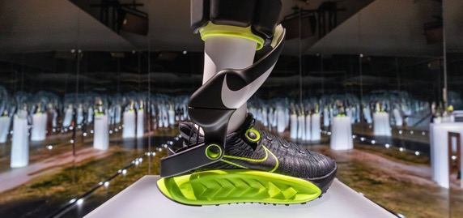
Collective
Worship
Invitation prayer
Bible link: Romans 12:2
Biblical value: Wisdom
Theme: The Tech Tug-of-War
Dear God,
Thank You for technology. Help us to use these amazing tools for learning, connection, and kindness.
Let us remember what is important and to use our time wisely.
Allow us to be the best we can be today, growing in our talents and wisdom.
Amen.
Pupil talk
What technology do you use in your day-to-day life? How is it helpful?
What is your favourite technology? Why?
What are some benefits to using technology?
How do you think technology might change the future? If you could invent a new technology, what would it be and why?
Key stage 1 class discussion
Would you rather find a quick answer on a computer or ask someone else and talk about it? Why?
Do you think our brains have to work harder when we play with something physical, such as a jigsaw, or when we watch a screen? How so?
Is it okay to have times when we don’t use technology? What activities might you do then?
Pupil involvement
Think
Start by reviewing the big question. There are two voting options for a below scenario.
Stand up (A): choose the technology or stay sitting (B): choose to use your own knowledge
You are not sure how to spell 'necessary’.
A) Use the spell-check feature on a computer or a digital assistant (like Alexa or Siri) to get the correct spelling.
B) Use your knowledge of phonics, try a few different spellings on paper, or look it up in a dictionary.
Does instant spell-check mean we stop learning to spell for ourselves?
Highlight that technology is designed to make things quicker and easier, but sometimes easier isn't always better.
This week, try to solve one problem yourself first (like a sum in your head or remembering a number) before using a technological tool.
Nike has revealed a new type of powered shoe, called Project Amplify, which uses small motors to boost a person’s walking and running movement. The shoes are designed to reduce tiredness and make everyday movement easier, especially for those who need extra support. Nike says the aim is to help people stay active, independent and mobile in their daily lives.
The modern world is busy, with fast, fun and easy technology. Technology is a useful tool which is not bad on its own, it just depends on how we use it. The Bible reminds us that if technology becomes a distraction and we rely on it too much, we should focus on what truly matters, like our contributions to the world, and the quality of our relationships with others.
Key stage 2 class discussion
What tasks or skills can technology now do for us?
Do you think it's important to still practice those skills, even if the technology can do them more quickly? Why?
A computer can often give us an instant answer. How does this make you feel, when you have to work hard to find an answer in a book, or solve a maths problem?
Worship song
Shine Jesus Shine
God
Creation
Fall
People of God
Incarnation
Gospel
Salvation
Kingdom of God
© Picture News 2025

