Slide 1
Class 3 Essential Knowledge
Autumn 2 2025

Slide 2
Spellings
Autumn 2 Year A
Weekly Spelling List
Visit our website to see ways you can support at home.
WEEK 1: Word roots, derivations and spelling patterns
grapheme, telegraph, autograph, graphics, microbe, microwave, microscope, microscopic, automobile, automatic, autoimmune, automaton
WEEK 2: Word roots, derivations and spelling patterns
defence, defensive, define, definite, refine, refined, phoneme, phonetic, television, telepathy, telescope, televisual
Week 3: Statutory Word List Revision (Y3/4)
address, answer, appear, arrive, believe, bicycle, breath, breathe, build, busy, business, calendar
WEEK 4: Plurals (s, es, ies)
balloons, words, ropes, buses, kisses, boxes, lunches, potatoes, cities, babies, parties, worries
WEEK 5: Apostrophes for contraction
didn’t, can’t, hadn’t, wouldn’t, shouldn’t, couldn’t, won’t, I’ll, we’ll, shan’t, don’t, haven’t
WEEK 6: Statutory Word List Revision (Y5/6)
definite, desperate, determined, develop, exaggerate, excellent, existence, explanation, marvellous, mischievous, muscle
Spelling Homework will be sent home each Wednesday and due the following Wednesday, relating to the spellings covered in lessons that week.

Slide 3
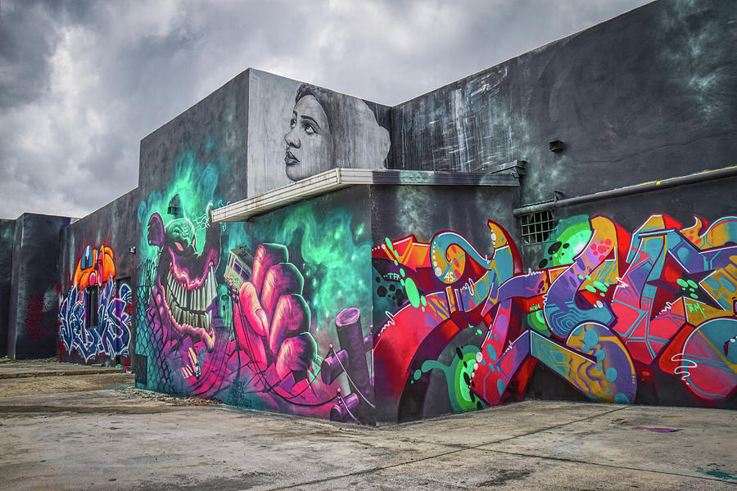
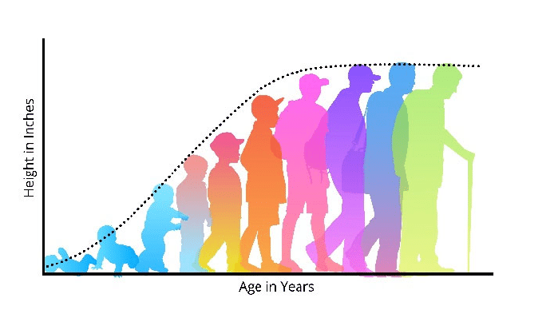

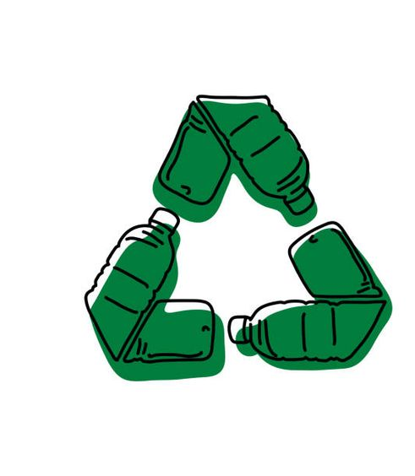
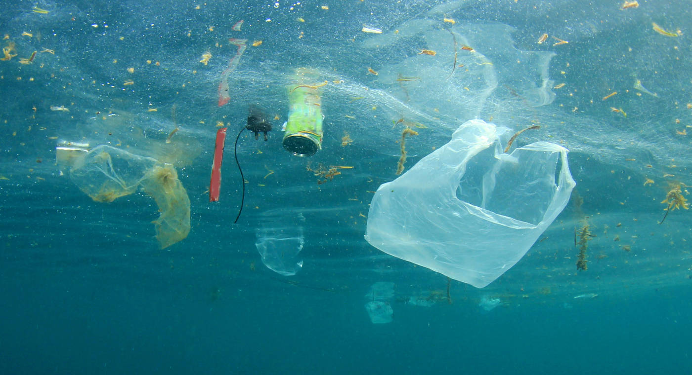
Writing
This half-term, we will be focusing on non-fiction structures in our writing, linking our geography learning about the world’s resources and our science knowledge about human development into our work.
Punctuation & Grammar
Previously taught
Expanded Noun Phrases
Fronted Adverbials (time)
New
Formal Tone
Bullet Points
Colon & Semi-Colon : ;
Persuasive adverbs
(surely, obviously etc …)
Adverbs of possibility
(perhaps, certainly etc …)
Cohesive devices
(one the one hand, however etc …)
Modal verbs
(could, should etc …)
Writing Outcomes:
A class debate about whether gender affects job roles.
A balanced argument about plastic pollution and/or art vs. graffiti
A formal, persuasive letter about deforestation and/or reducing the use of plastic in our school
A persuasive brochure about Hulland Ward CofE Primary School
A non-chronological report about human development
A short winter-themed story (last week)

Slide 4
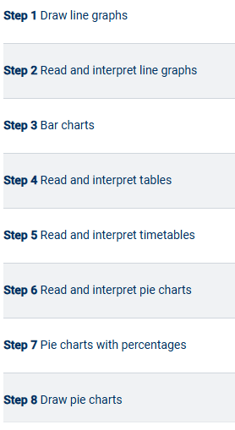
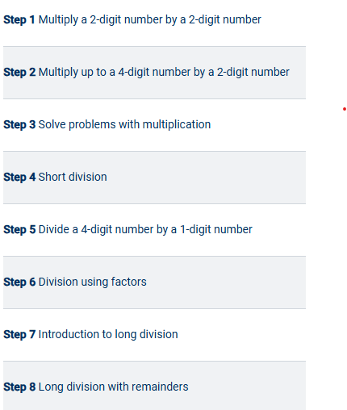
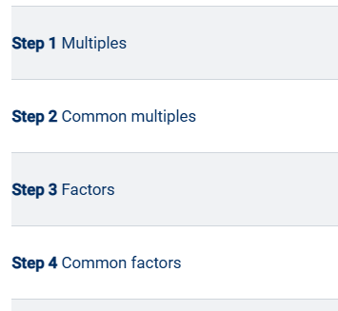

Maths – Miss Hunter
Week 5, 6 & 7 –
Statistics
Please log on to Times Tables Rockstars (TTRS) as much as possible! Times tables up to 12 x 12 are essential for the Year 5 & 6 National Curriculum and underpin many other topics, including fractions, percentages and formal written methods.
Logins and passwords are in Reading Record Books.
Week 1 – Multiplication & Division A continued …
Week 2, 3 & 4 –
Multiplication & Division B

Slide 5
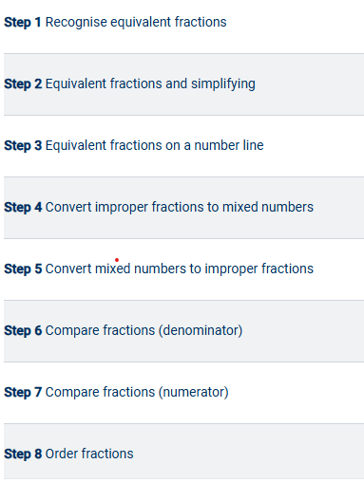
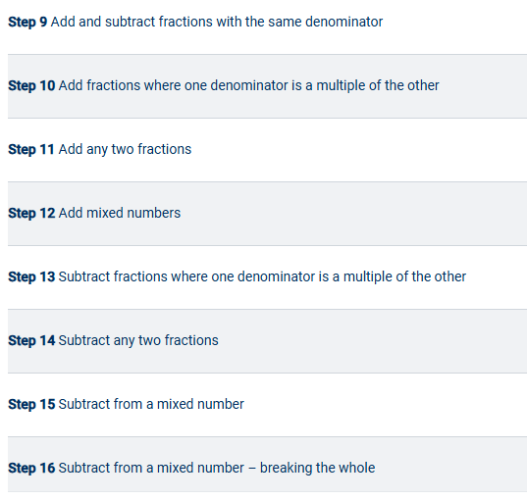
Maths – Mrs Skinner
7 Weeks – Fractions A

Slide 6
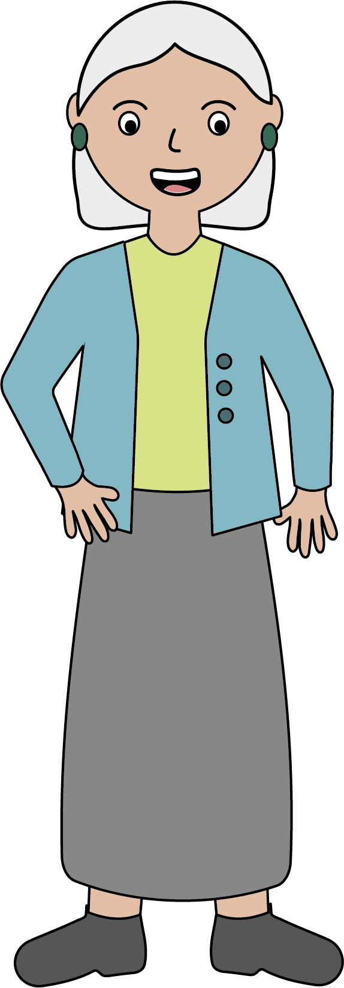
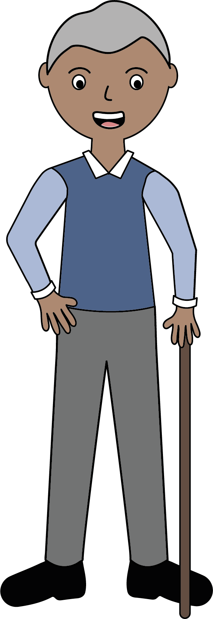
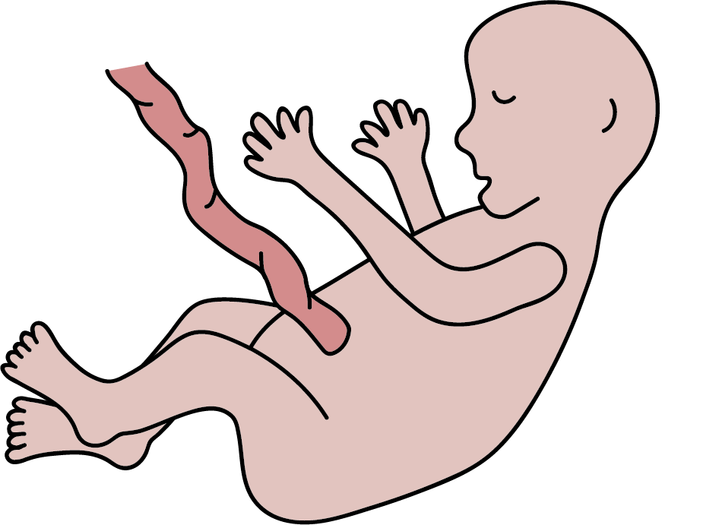
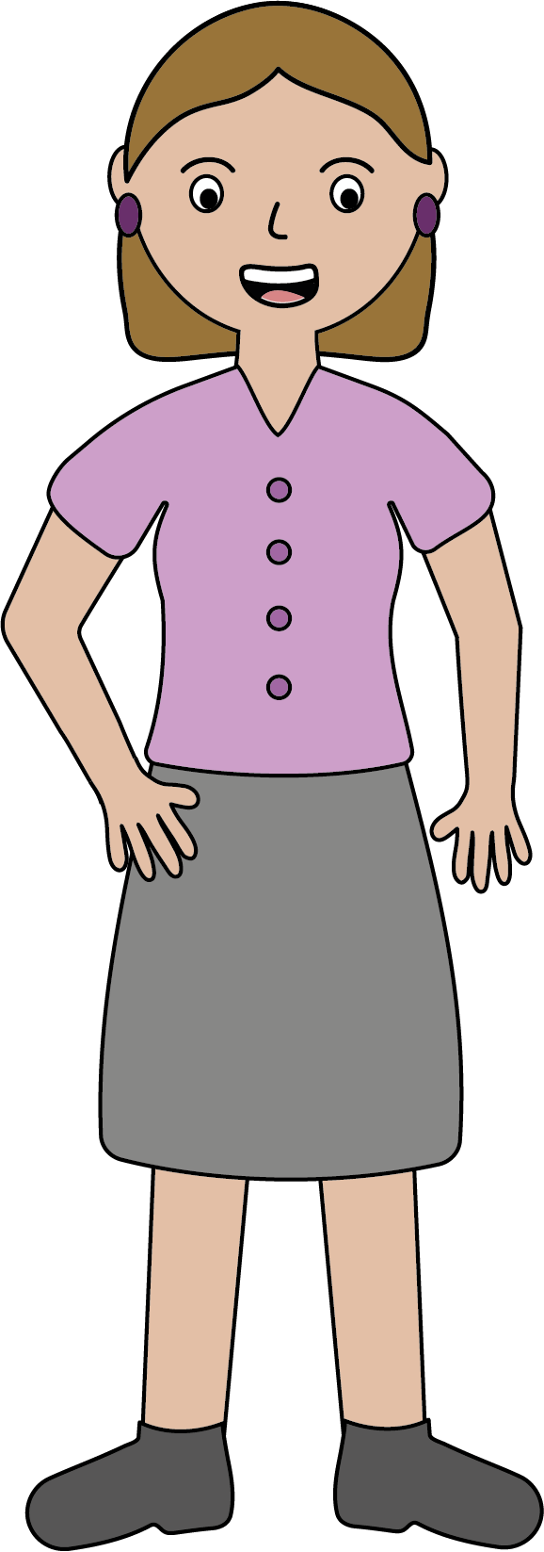
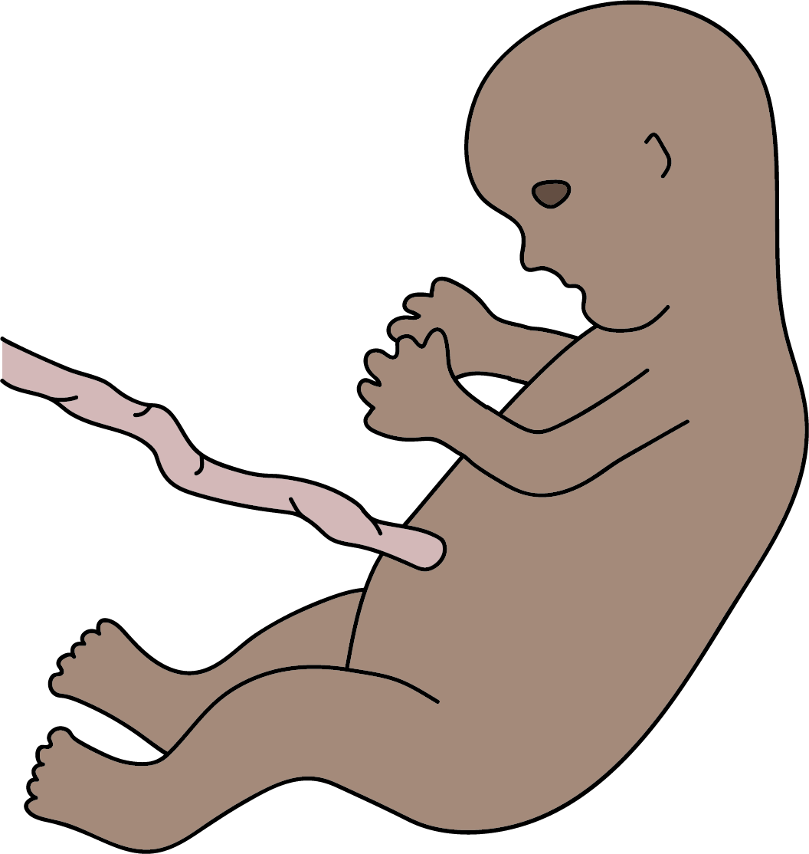
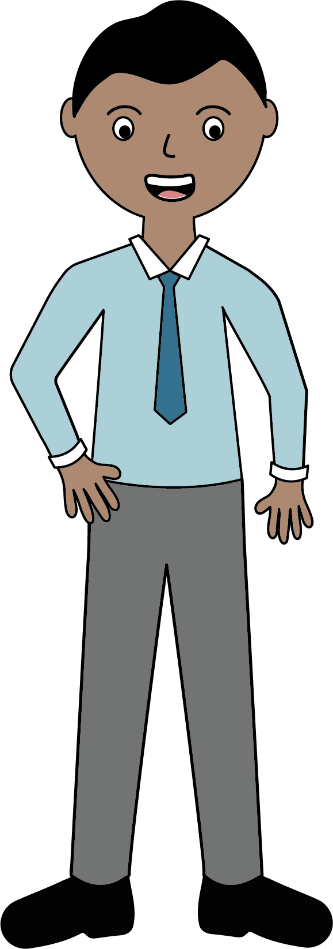

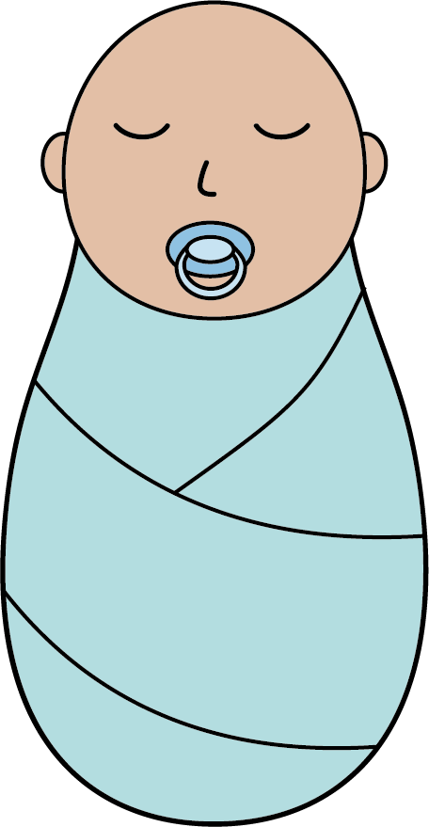
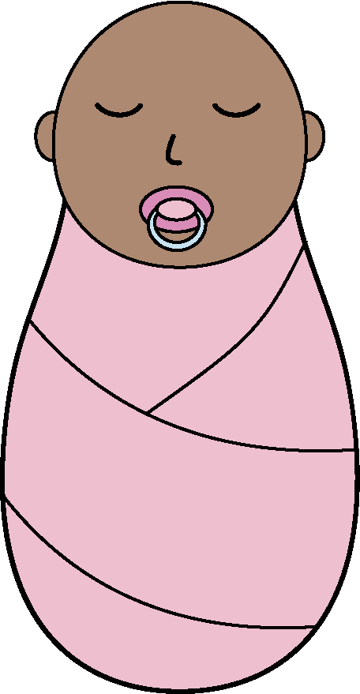
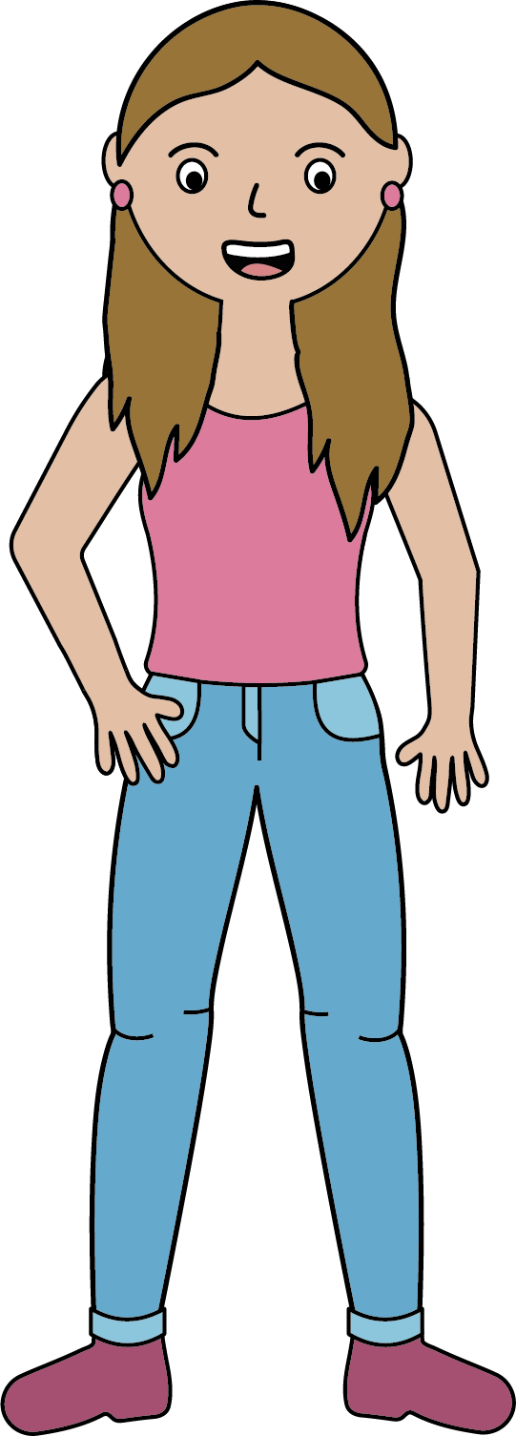
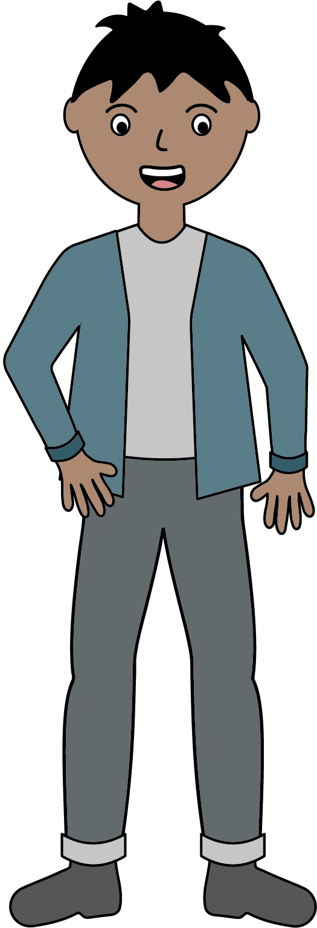
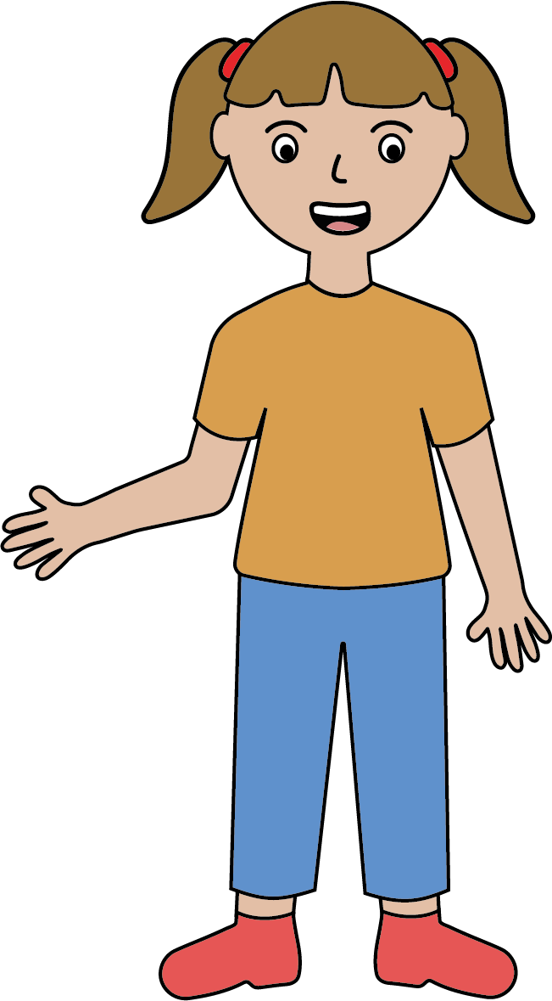
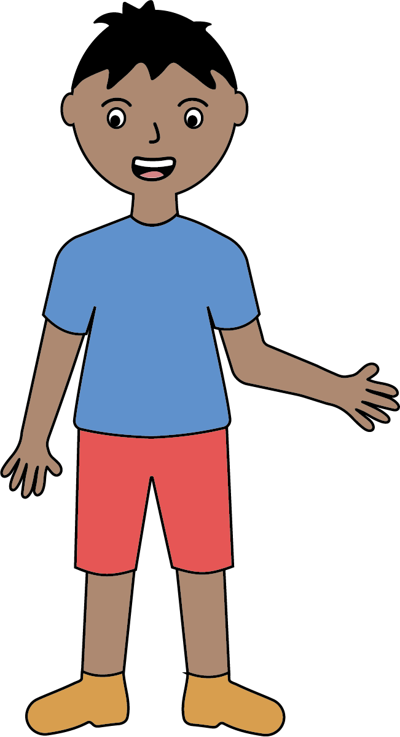
Science – Biology – Human Development
The human life cycle
During adulthood, we age. Primary ageing is a natural process that happens as our bodies get older. Our reaction times slow and our hearing gets worse. If we smoke, eat a bad diet and don’t exercise, this accelerates how much we age. This is called secondary ageing.
Adults can reproduce, and their offspring continue the life cycle.
Gestation is the period from conception to birth. In humans, this is often 40 weeks. During this time, a ball of cells develops into a foetus.
Humans are viviparous animals. This means the foetus develops inside the female.
old age
foetus
foetus
adult
baby
adult
Puberty is a topic within the National Primary Curriculum for Science and is therefore compulsory. If you have any concerns or questions about it, please contact Miss Hunter.
baby
Puberty occurs during adolescence and is a period of time when the male and female body undergoes change. Pubic hair grows, breasts develop, males produce sperm and females begin to menstruate.
At birth, a baby is born and will grow into a child. The child begins to develop and grow bigger. Children start to walk at about 1 year old and will begin to use words from about 18 months. Their speech becomes more advanced as they get older.
teenager / adolescent
child
teenager / adolescent
child

Slide 7
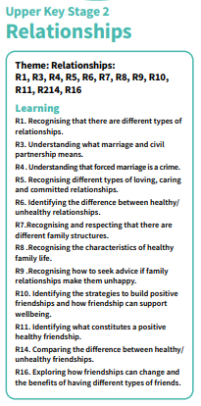
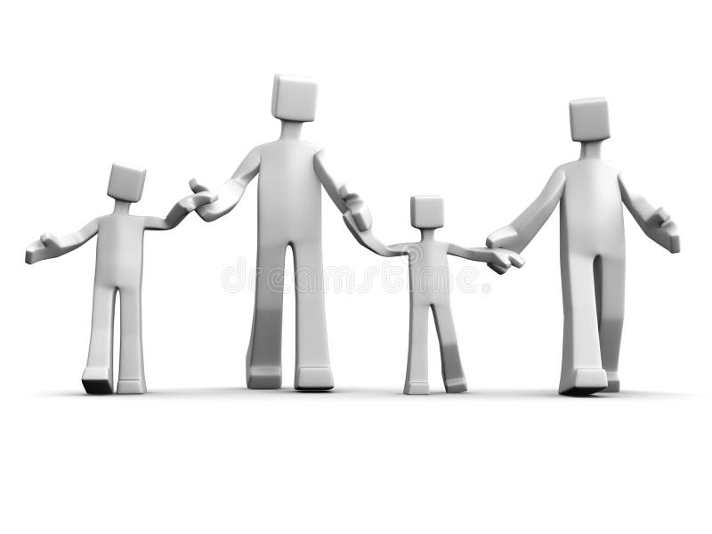
PSHE – Relationships
In PSHE, we are going to look at the different types of relationships in our lives, including friendships and family relationships.
We will reflect on the good qualities a healthy relationship should have as well as identify strategies to manage relationship issues, such as peer pressure. We will identify ways to positively resolve disputes and/or reconcile differences.
We will also explore and respect that there are different family structures in society and that friendships may look different too.

Slide 8

Computing – Systems & Networks - Searching
This half-term, children will develop their understanding of computer systems and how information is transferred between systems and devices.
By the end of this half-term, children will be able to explain the input, output and process aspects of different real-world systems. They will discover how information is found on the World Wide Web; learning how search engines work (including how they select and rank results) and what influences searching.

Slide 9
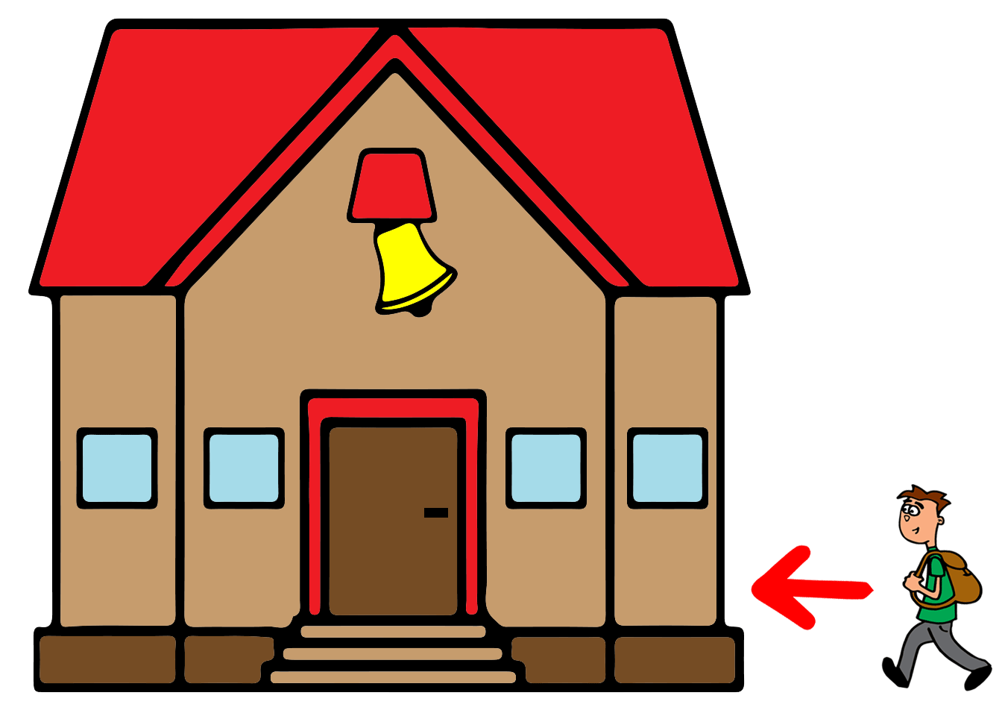
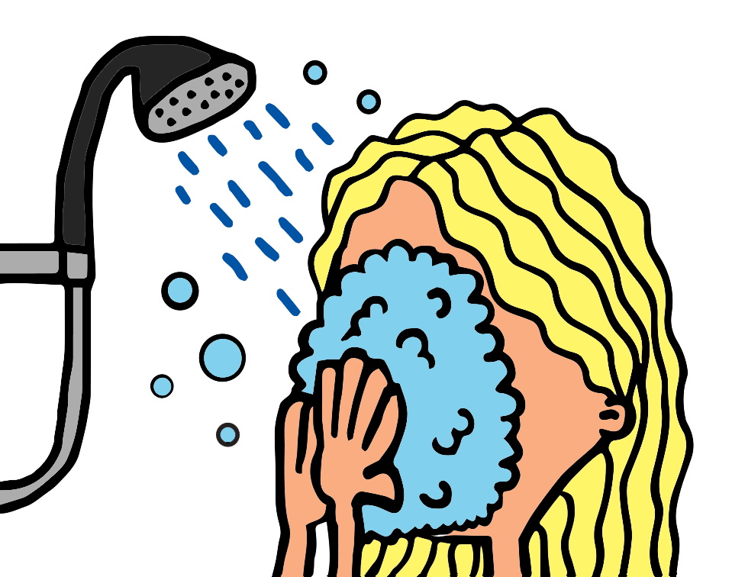
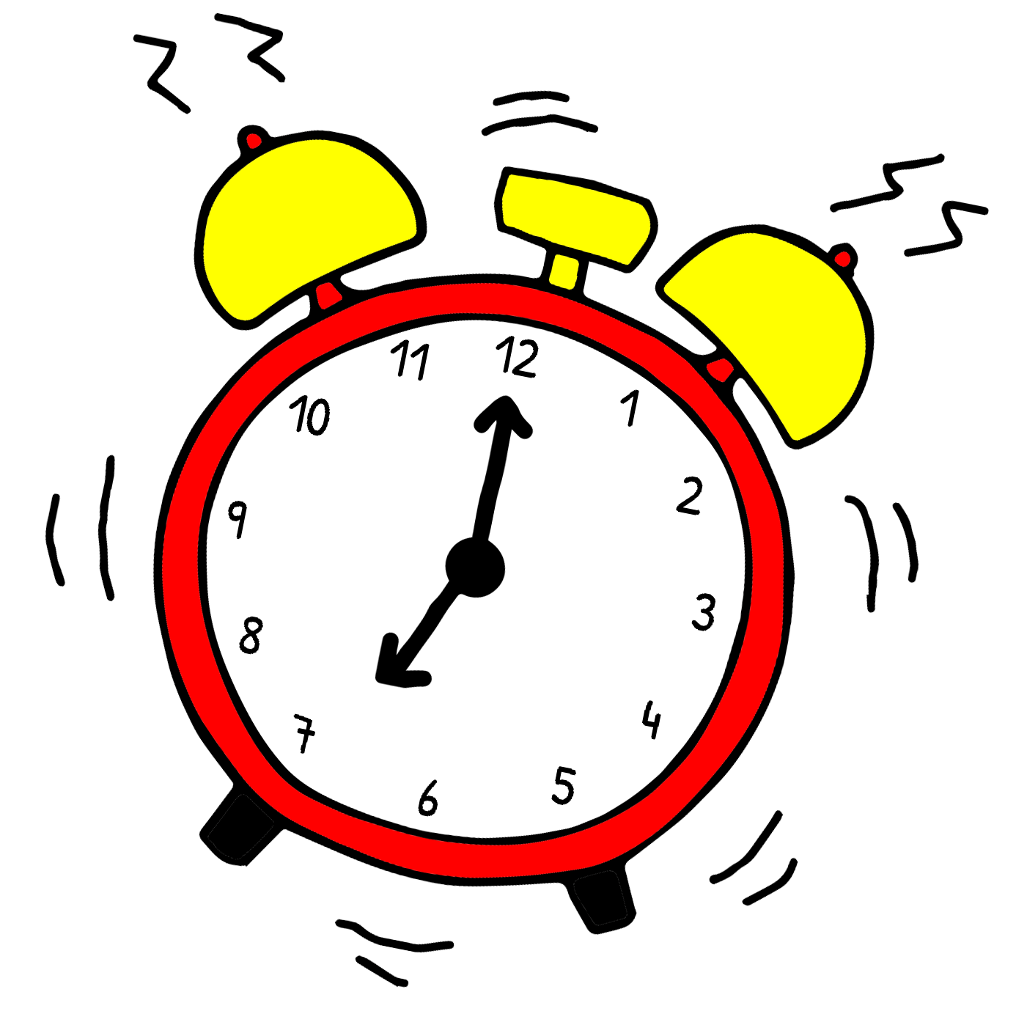
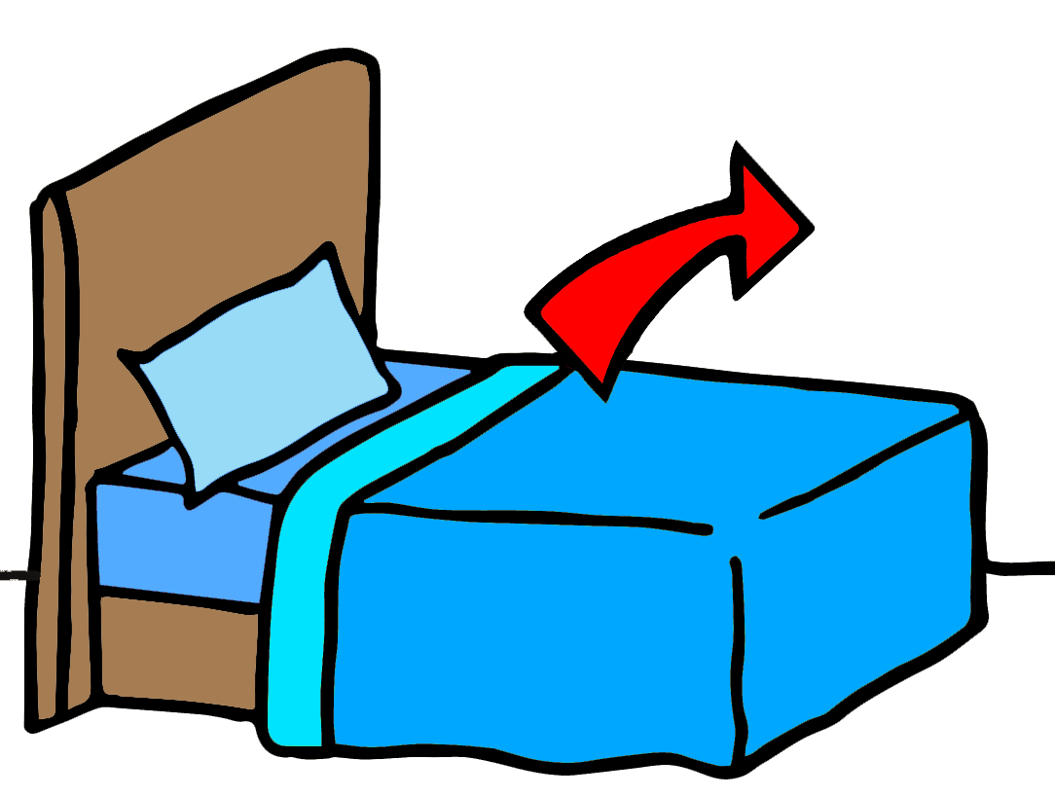
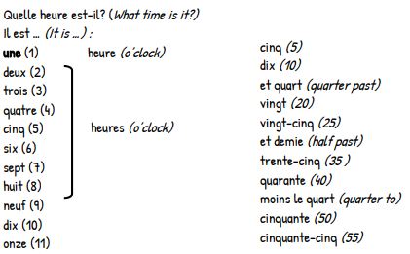
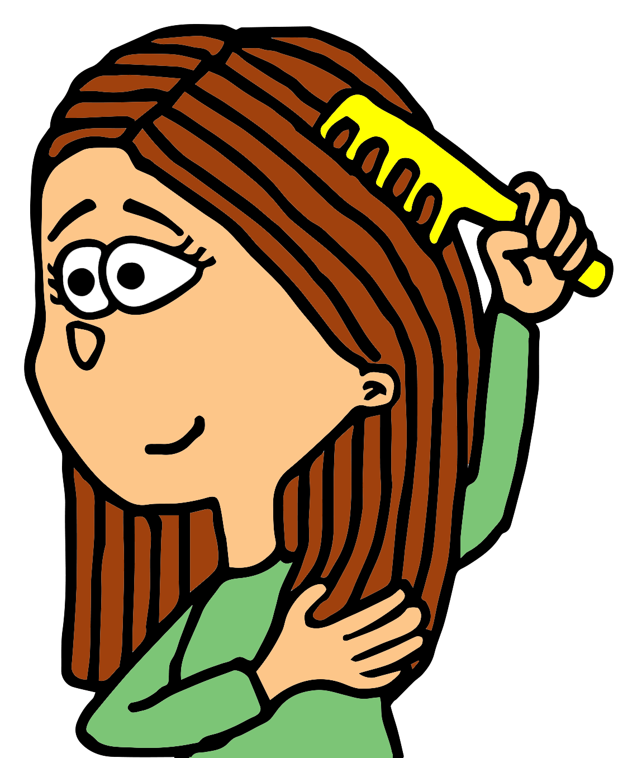
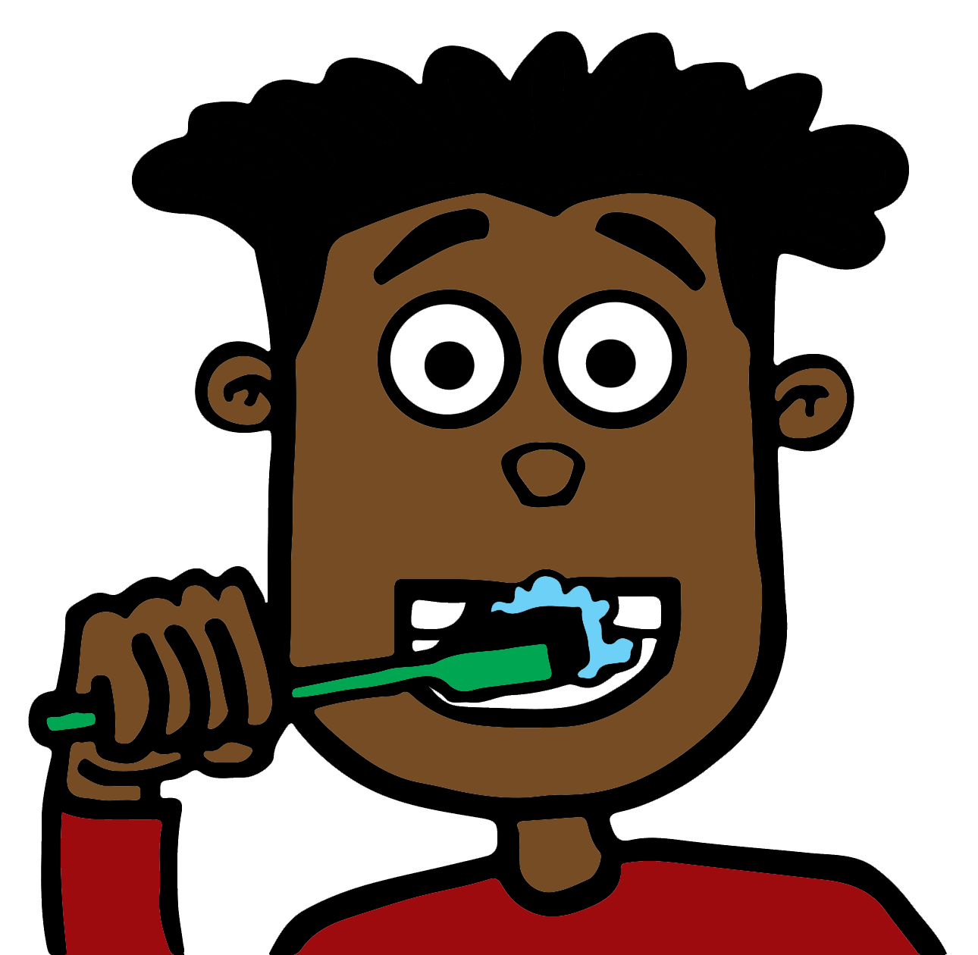
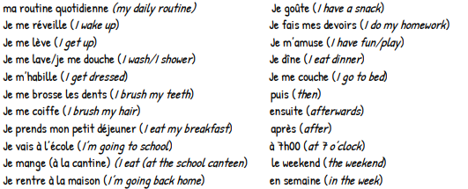

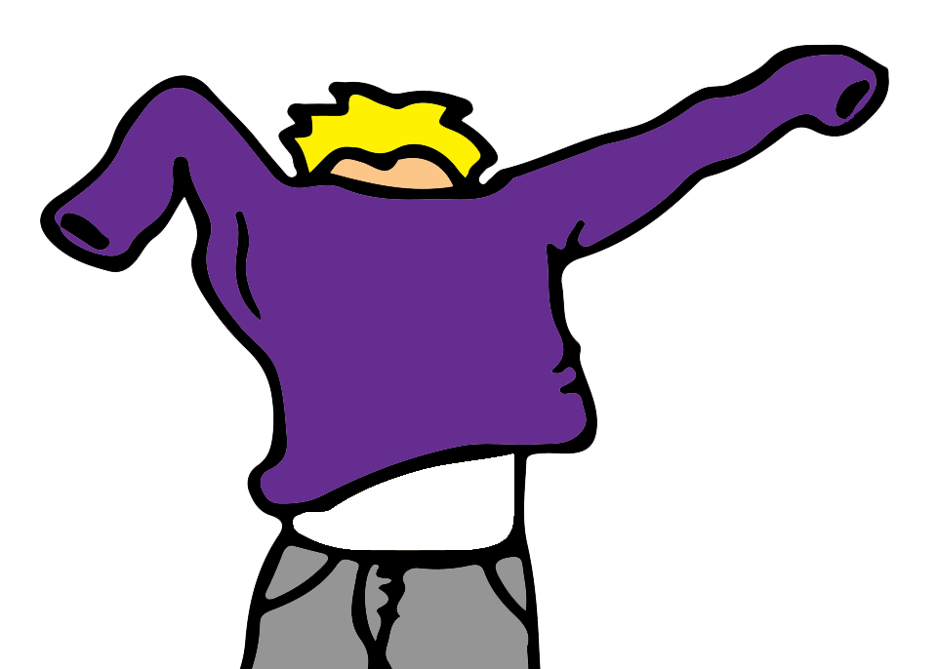
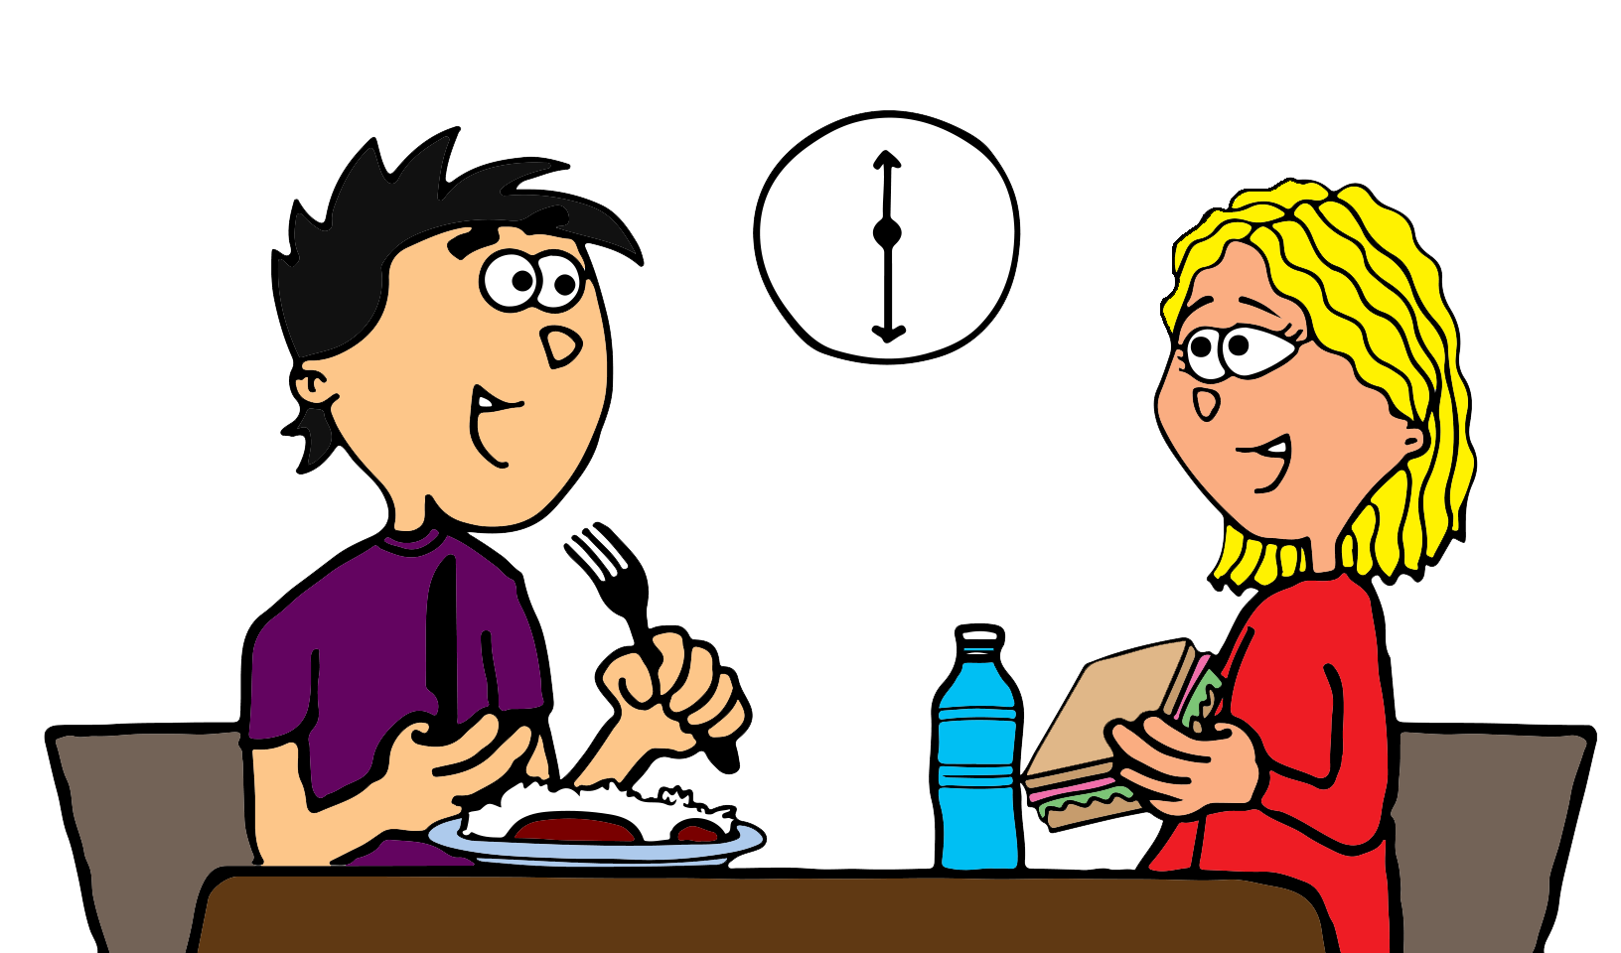
French – Time & Daily Routine
En français – le temps et la routine quotidienne

Slide 10
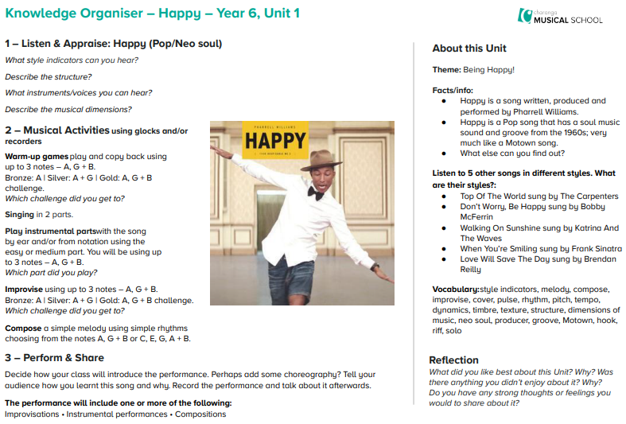

Music
We will now
be following
the
Charanga
Scheme
of Work in
Music,
beginning
with the unit
‘Happy’.

Slide 11
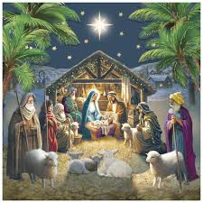

R.E - What would Jesus do?
(Can we live by the values of Jesus in the twenty-first century?)
By the end of this module, children should be able to:
• Outline Jesus’ teaching on how his followers should live.
• Offer interpretations of two of Jesus’ parables and say what they might teach Christians about how to live.
• Explain the impact Jesus’ example and teachings might have on Christians today.
• Express their own understanding of what Jesus would do in relation to a moral dilemma from the world today.

Slide 12

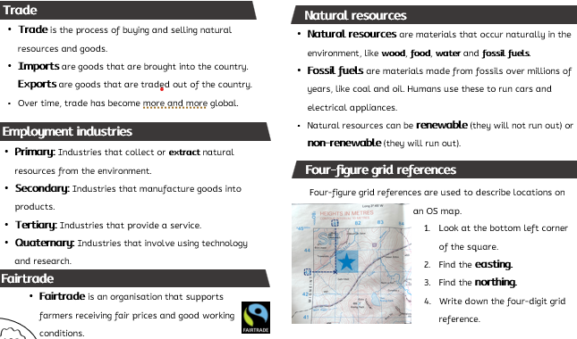
Geography
Investigating distribution of the world’s resources and trade.

Slide 13
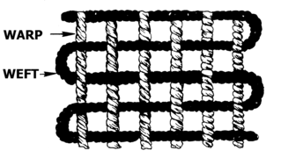
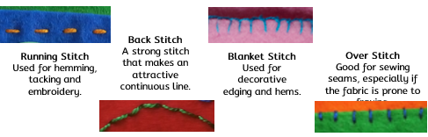
Design & Technology
Children will design and produce made to measure hats and head coverings.
Parts of a fabric
Stitch | Purpose
warp | The threads in a fabric that run up and down.
weft | The threads in a fabric that run left to right.
selvedge | The self-finished edge of a piece of fabric.
straight grain | The fabric does not stretch much in this direction.
cross grain | The fabric is more stretchy in this direction.
Making
Sewing patterns:
used to communicate design ideas
used to mark out fabric pieces
can be made of paper of a CAD file.
Permanent Fastenings | Temporary Fastenings
running stitch back stitch over stitch fusing | buttons ribbons velcro press studs zips hooks and loops
Fastenings:
used to join fabrics
can be permanent or temporary.
cross grain
Types of stitches
warp
straight
grain
selvedge
weft

